Slide 1
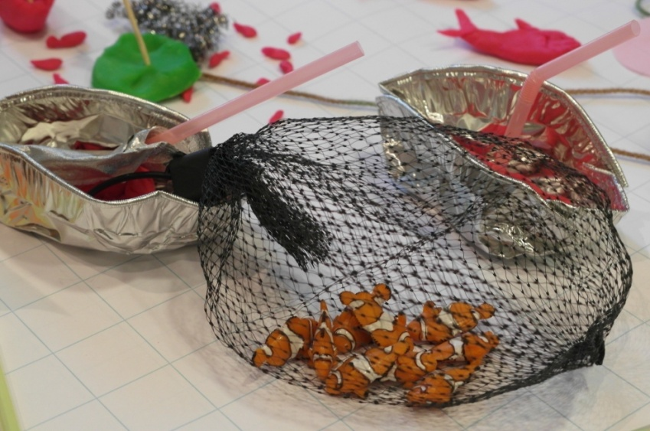
TUNA THINK TANK
SUMMARY REPORT
August 31, September 1 and 2, 2010.
Hosted by
Wageningen University and the WWF Coral Triangle Programme
Organizing committee
Lida Pet-Soede, Jose Ingles, Vishwanie Maharaj,
Paul van Zwieten and Simon Bush
Facilitators
Martin Kalungu-Banda and Emil Sumirat

Slide 2
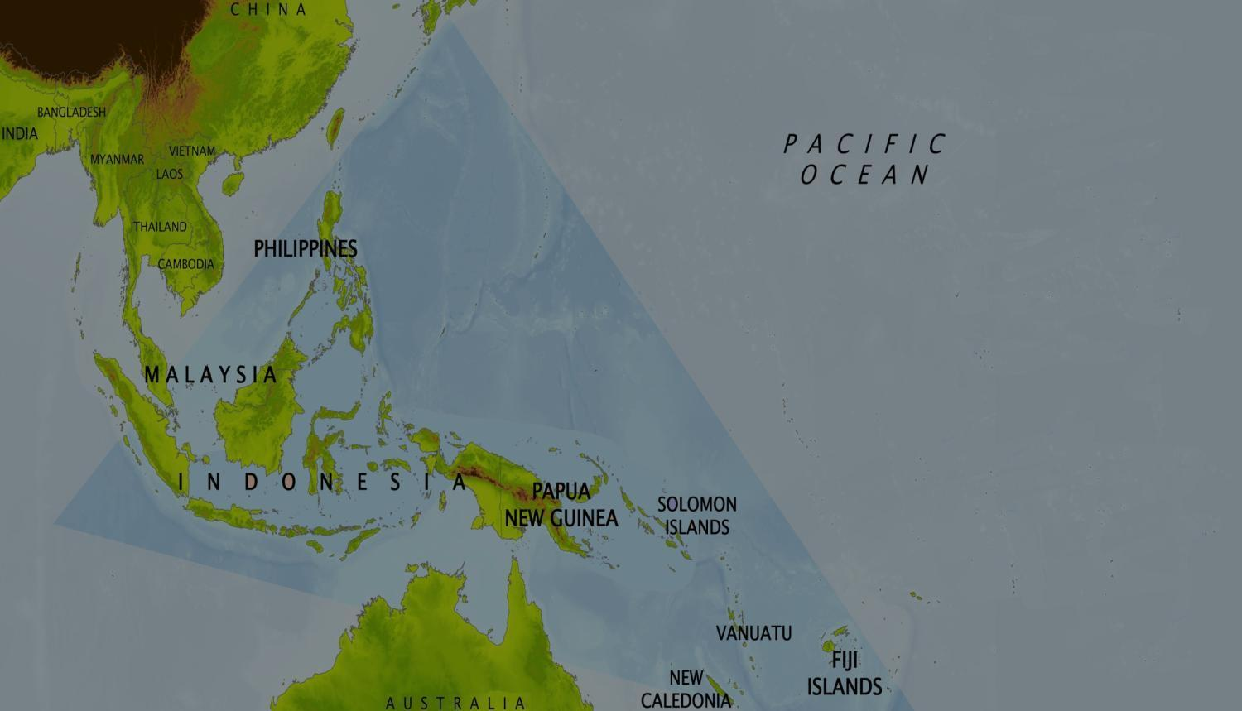
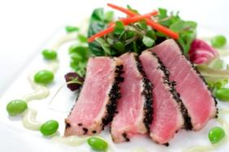
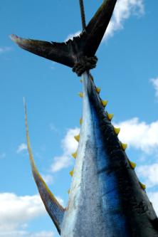
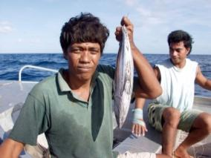
The Issue
Top Consumers: Japan, US, EU, China, Thailand
Tuna spawning areas
?
$
Fishing
Fleets
Local Fishing Communities
Notes:
2
Here is the problem. None of that revenue finds its way back to the local communities managing the spawning areas and juvenile populations.
As a consequence, they have no financial incentive to manage their fisheries sustainably. At the moment, they are taking large numbers of juvenile yellow fin and big eye before they can reach maturity.
The Fisheries Management Organization that covers the Pacific and attempts to manage this wide-ranging stock across the waters of many nations. They are demanding that the fishermen in the Coral Triangle change their practices and reduce this off-take.
But why should they? As the economists say - both parties are behaving rationally. They are fishing within their rights and within their means. Without any financial or regulatory incentive - they will keep on fishing those juveniles.
This system is broken and we aim to fix it.

Slide 3
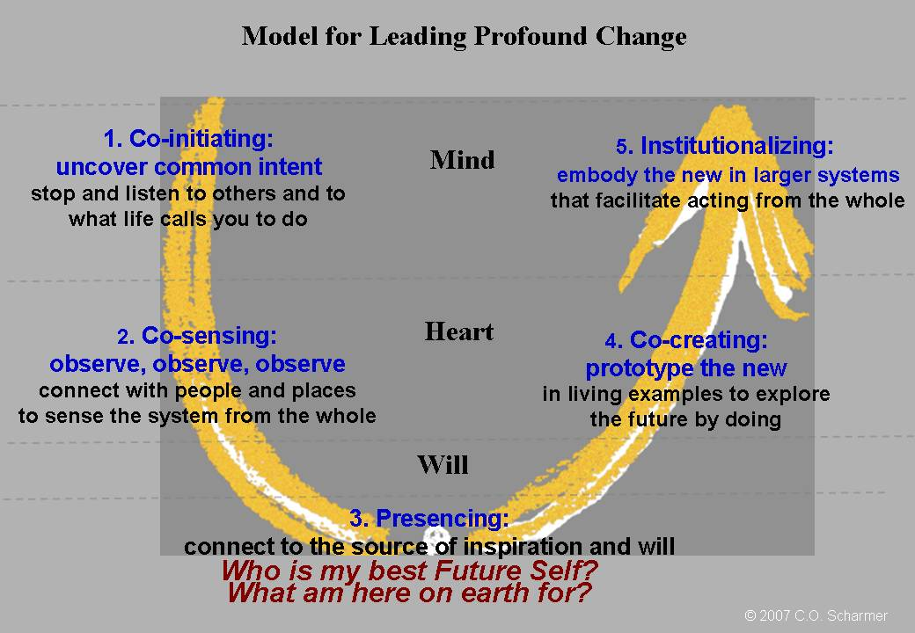
The Method

Slide 4
The Agenda
Day 1: Co-Creating Common Intent
Creating Common Intent
Preparing ‘Self’ for taking in new Data
Day 2: Co-Sensing the Field and Co-Presencing:
Bringing the reality of the situation into the room
Co-Presencing
Day 3: Co-creating the new - Next Steps
Select from the long list what should be taken for prototyping.
Ddialogue and agree next steps for desired change

Slide 5
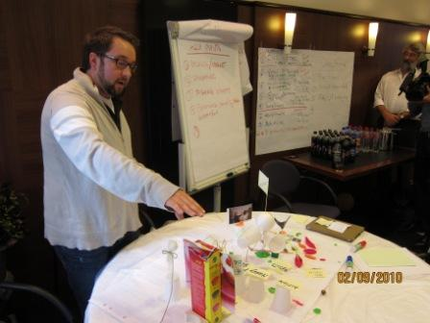
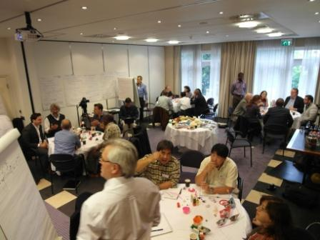
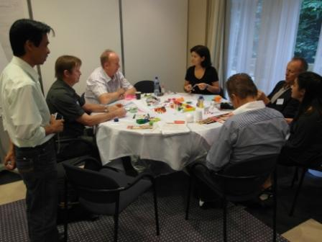
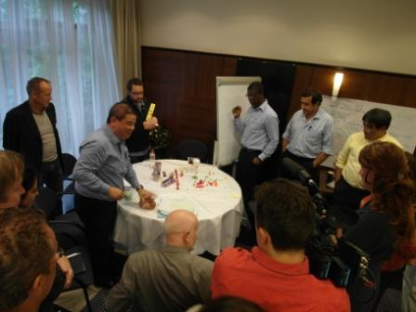
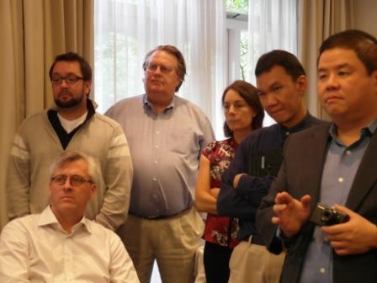
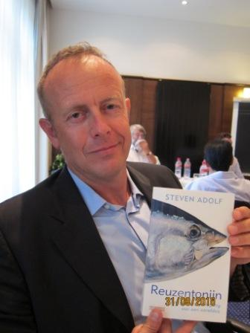
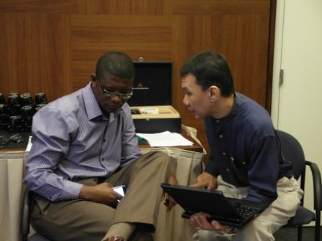
The Participants

Slide 6
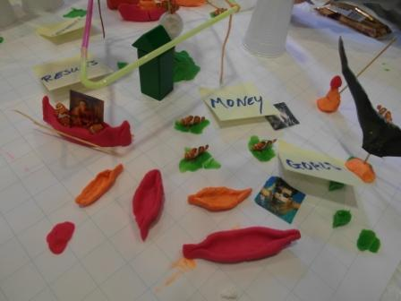
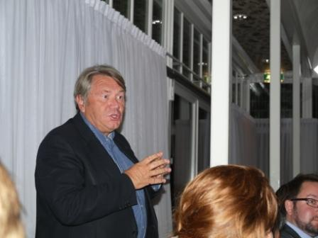
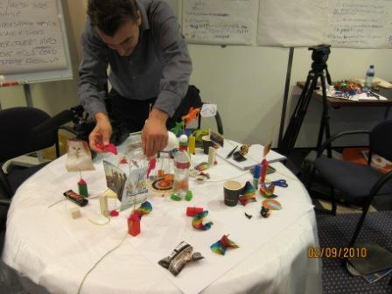
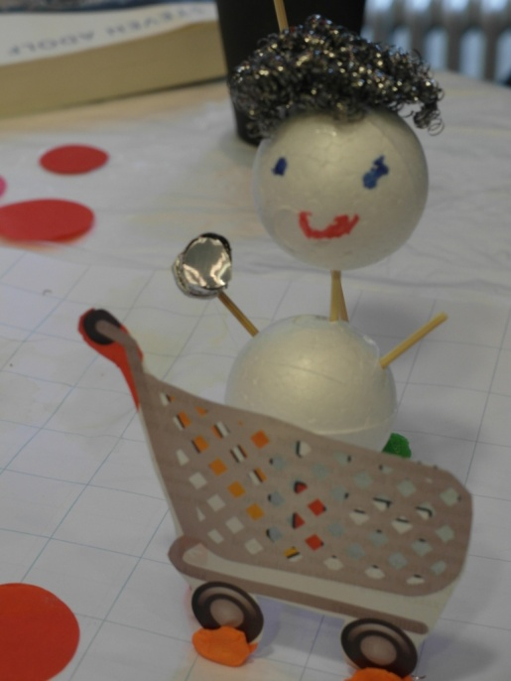
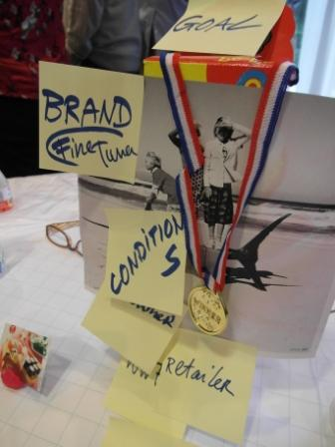
The Work

Slide 7
The Outcomes
1. Business driven approaches to stop canning juveniles
Assist the development of retail sourcing policy and brand strategies for reducing the use of juveniles in the canning industry, either by addressing by-catch or reduced capacity and effort of small purse seiners.
2. Financial incentives and cap-and-trade
Reducing juvenile by-catch in the purse seine fleet implemented by purse seine organizations. Given the diversity of these industry organizations, three options were identified 1) an incentive fund to reward crews on vessels with the lowest big-eye juvenile catches, 2) a cap and trade scheme that operates on a private sector allocation basis that may lead to capacity reduction and/or 3) a credit/quota scheme to ‘tax’ the catch of juveniles.
3. Documentary film
Creating awareness through a documentary film on two key aspects of the tuna fisheries of the Western Pacific – the tuna lifecycle, with a focus on juvenile ecology, and the challenges of sustainability in the Coral Triangle, with attention given to fisher’s livelihoods and international trade.
4. ‘Get a new net’ program
A hand in program or ‘amnesty’ to hand in small mesh nets and fund reinvestment in larger mesh nets, with the goal of allowing a higher percentage of juveniles to escape and higher value of the fish caught.
5. FADs to TADs
Reduce fishing on fish attraction devices (FADs) by turning them into tourist attraction devices (TADs), thereby reducing effort and by-catch of juveniles while also providing alternative opportunities for coastal fleets in diving and sports fishing tourism.

Slide 8
The Follow Up
The Coral Triangle Program of WWF is keen to take next step in the process and is identifying who should be involved in the development of these prototypes. A draft approach is available and we are reaching out to some of the participants to initiate prototype “clusters”.
Each prototype ‘cluster’ should then identify what new ideas (or new details on ‘old’ ideas) will be further detailed to carry forward, as well as what configuration of people can initiate change through their normal working lives.
Within 6 months after this tuna think tank, WWF aims to organise a consultation meeting in the CT and Western Pacific region to discuss some of these prototypes with regional stakeholders to the relevant issue.
Following this, we aim to implement some of the prototypes.

Slide 9
Resources
www.panda.org/coraltriangle/tunathinktank

