Slide 1




An NGO perspective: A multi-sector, multi stakeholder approach to aiding fisheries recovery through establishing a resource managed area
MMatillano
WWF-Philippines presentation to
THE ASIA PACIFIC ECONOMIC COOPERATION (APEC)
WORKSHOP ON
MARKET-BASED IMPROVEMENT IN LIVE REEF FISH FOOD TRADE (LRFFT)
SANUR PARADISE PLAZA HOTEL & SUITES
BALI, INDONESIA
1st-3rd March, 2011
Notes:
ADD LOGOS: PCSD, PROVINCE, BFAR, WWF

Slide 2
Presentation Outline
Title
Overview
Stakeholders
Sectoral perspective on LRF sustainability
The role of WWF

Slide 3
KEY PLAYERS AND STAKEHOLDERS
Provincial Government
Line Agencies from National Government
LGU’s
PCSD/S
TRADERS’ GROUP (PALIFTA / KAWIL)
Private establishments / resorts
FARMC’s and Fisherfolks
NGO’s
Academe

Slide 4
Sectoral perspective
Notes:
INSERT INTERESTS PER SECTOR IE LGU: REGULATIONS / LIVELIHOOD / CONSTITUENCY; ACADEME: SCIENCE AND SUSTAINABILITY; INDUSTRY: LIVELIHOOD/INCOME; COMMON INTEREST: SUSTAINABILITY
NGO: PROVIDES PLATFORM FOR CONVERGENCE THRU SCIENCE WORK (BIOLOGICAL AND SOCIO-INSTITUTIONAL), DEVELOPMENT OF PLANS
NGO PERSPECTIVE COVERS INTER-MUNICIPAL TRANS-BOUNDARY CONCERNS ALONG WITH PROVINCIAL INSTITUTIONS
NGO ALSO PROVIDES FUNDING LEVERAGE

Slide 5
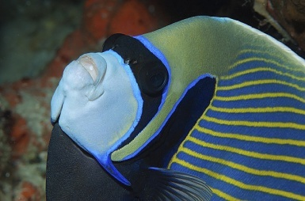
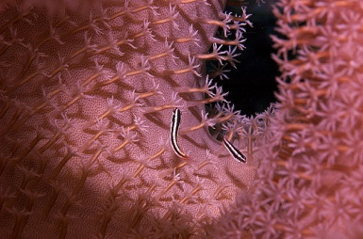
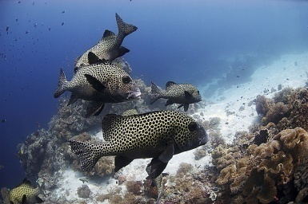
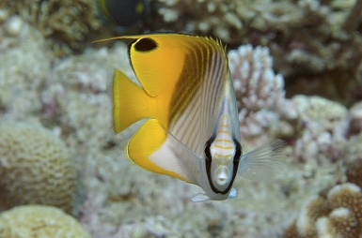
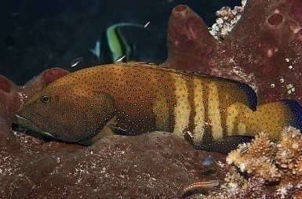
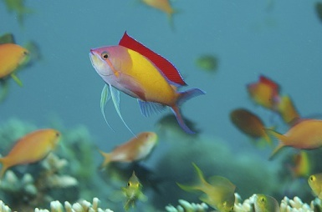
WWF Current initiatives in support of LRFF sustainability in Palawan
Coral Triangle Support Program (Province-wide)
Coral Triangle Network Initiative (Taytay)
Live Reef Food Fish Sustainability (Quezon)
Tubbataha MPA (Cagayancillo)

Slide 6
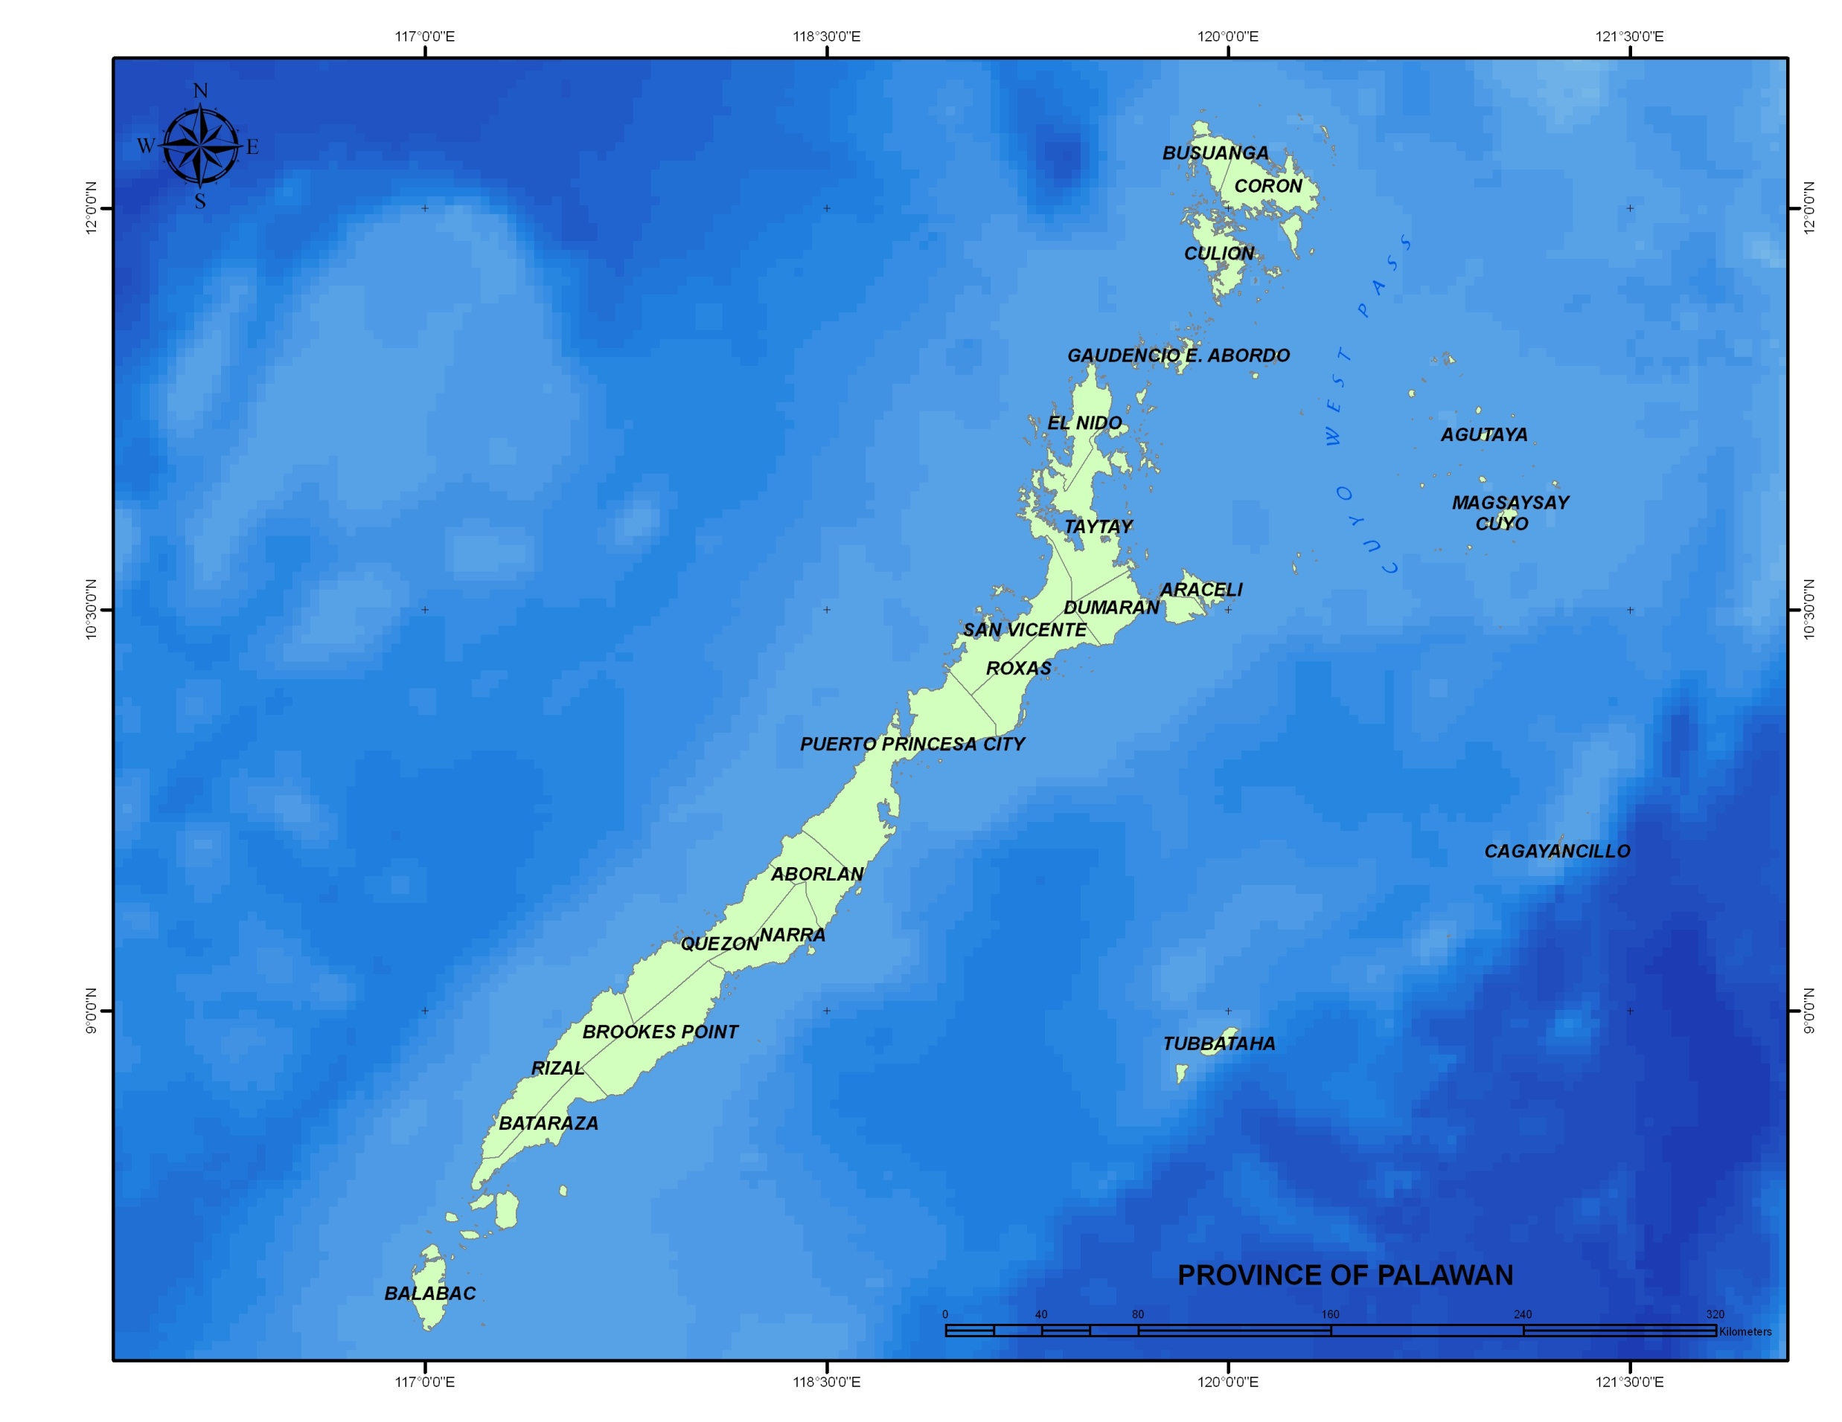
LRFFS Support projects and Sites in Palawan
LRFT cluster
LRFT exploratory
MPA effectiveness
EAFM Expansion Area

Slide 7
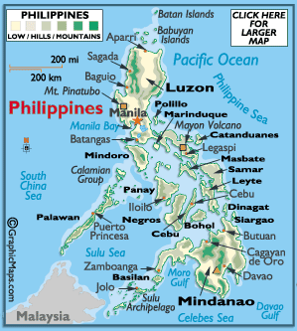
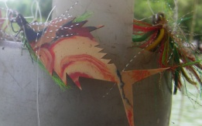
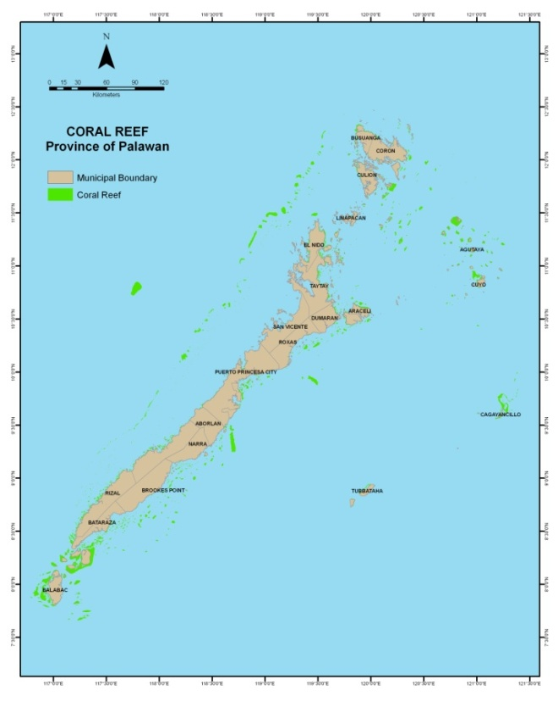
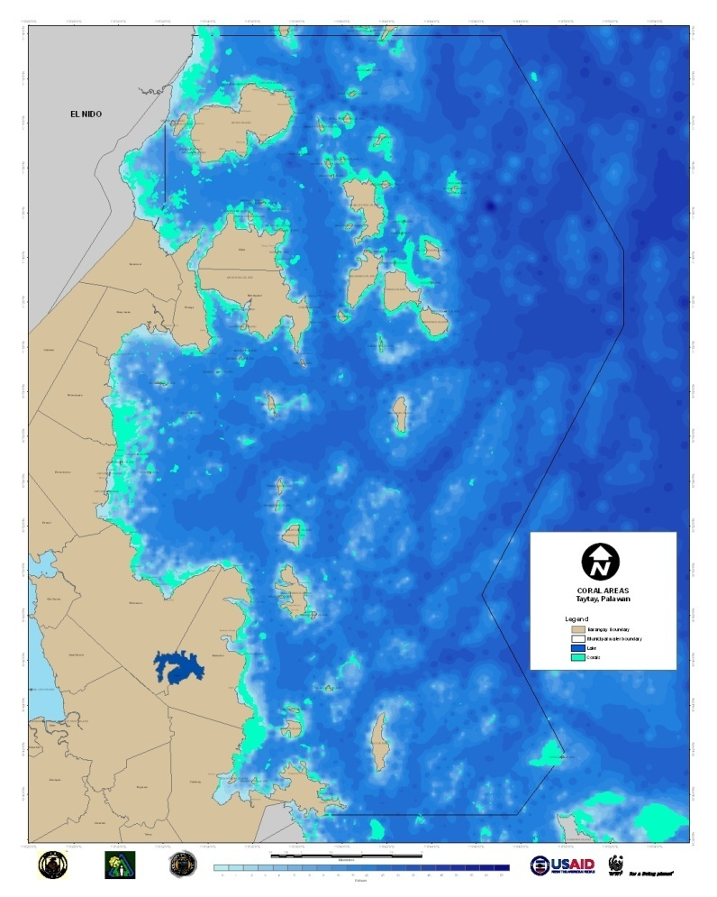
LOCATION
PALAWAN
TAYTAY BAY

Slide 8
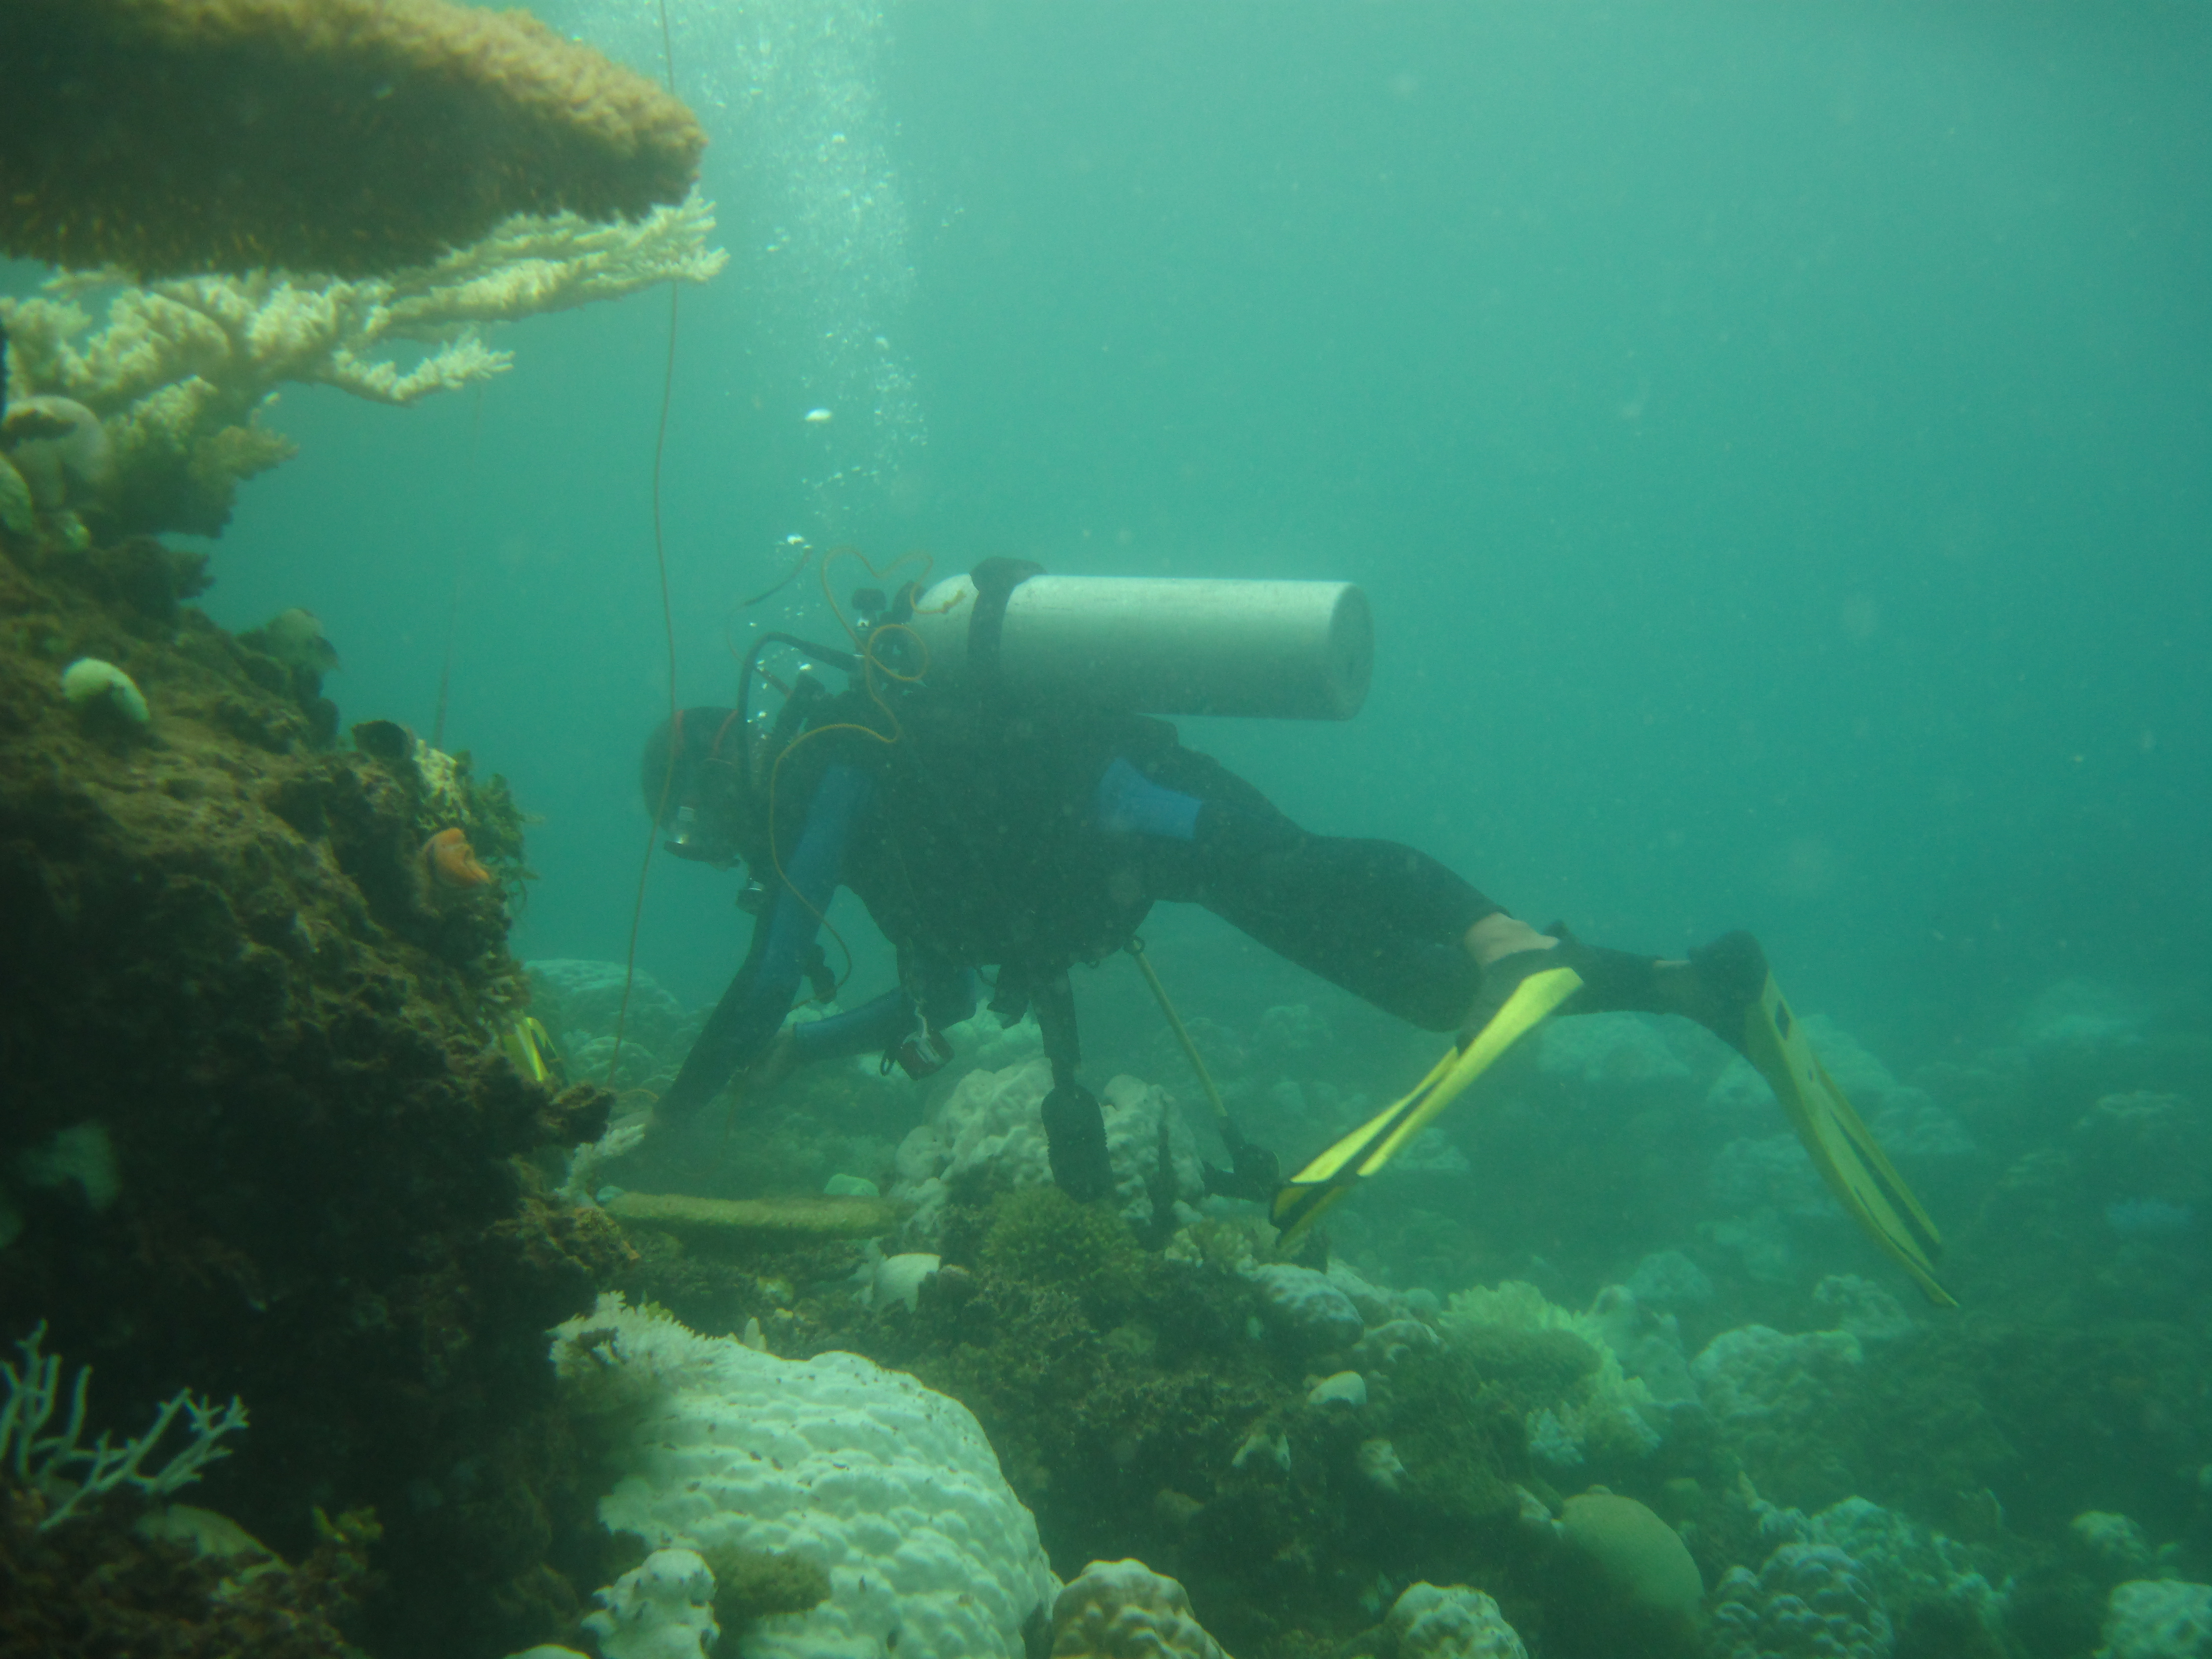
Intervention outline
1. Baseline Data Gathering and Review of Existing efforts
Existing policies and current practices / systems re LRFF sector
Scientific and socio-economic assessments
Environmental Law Enforcement Capability Index
Gaps identification

Slide 9
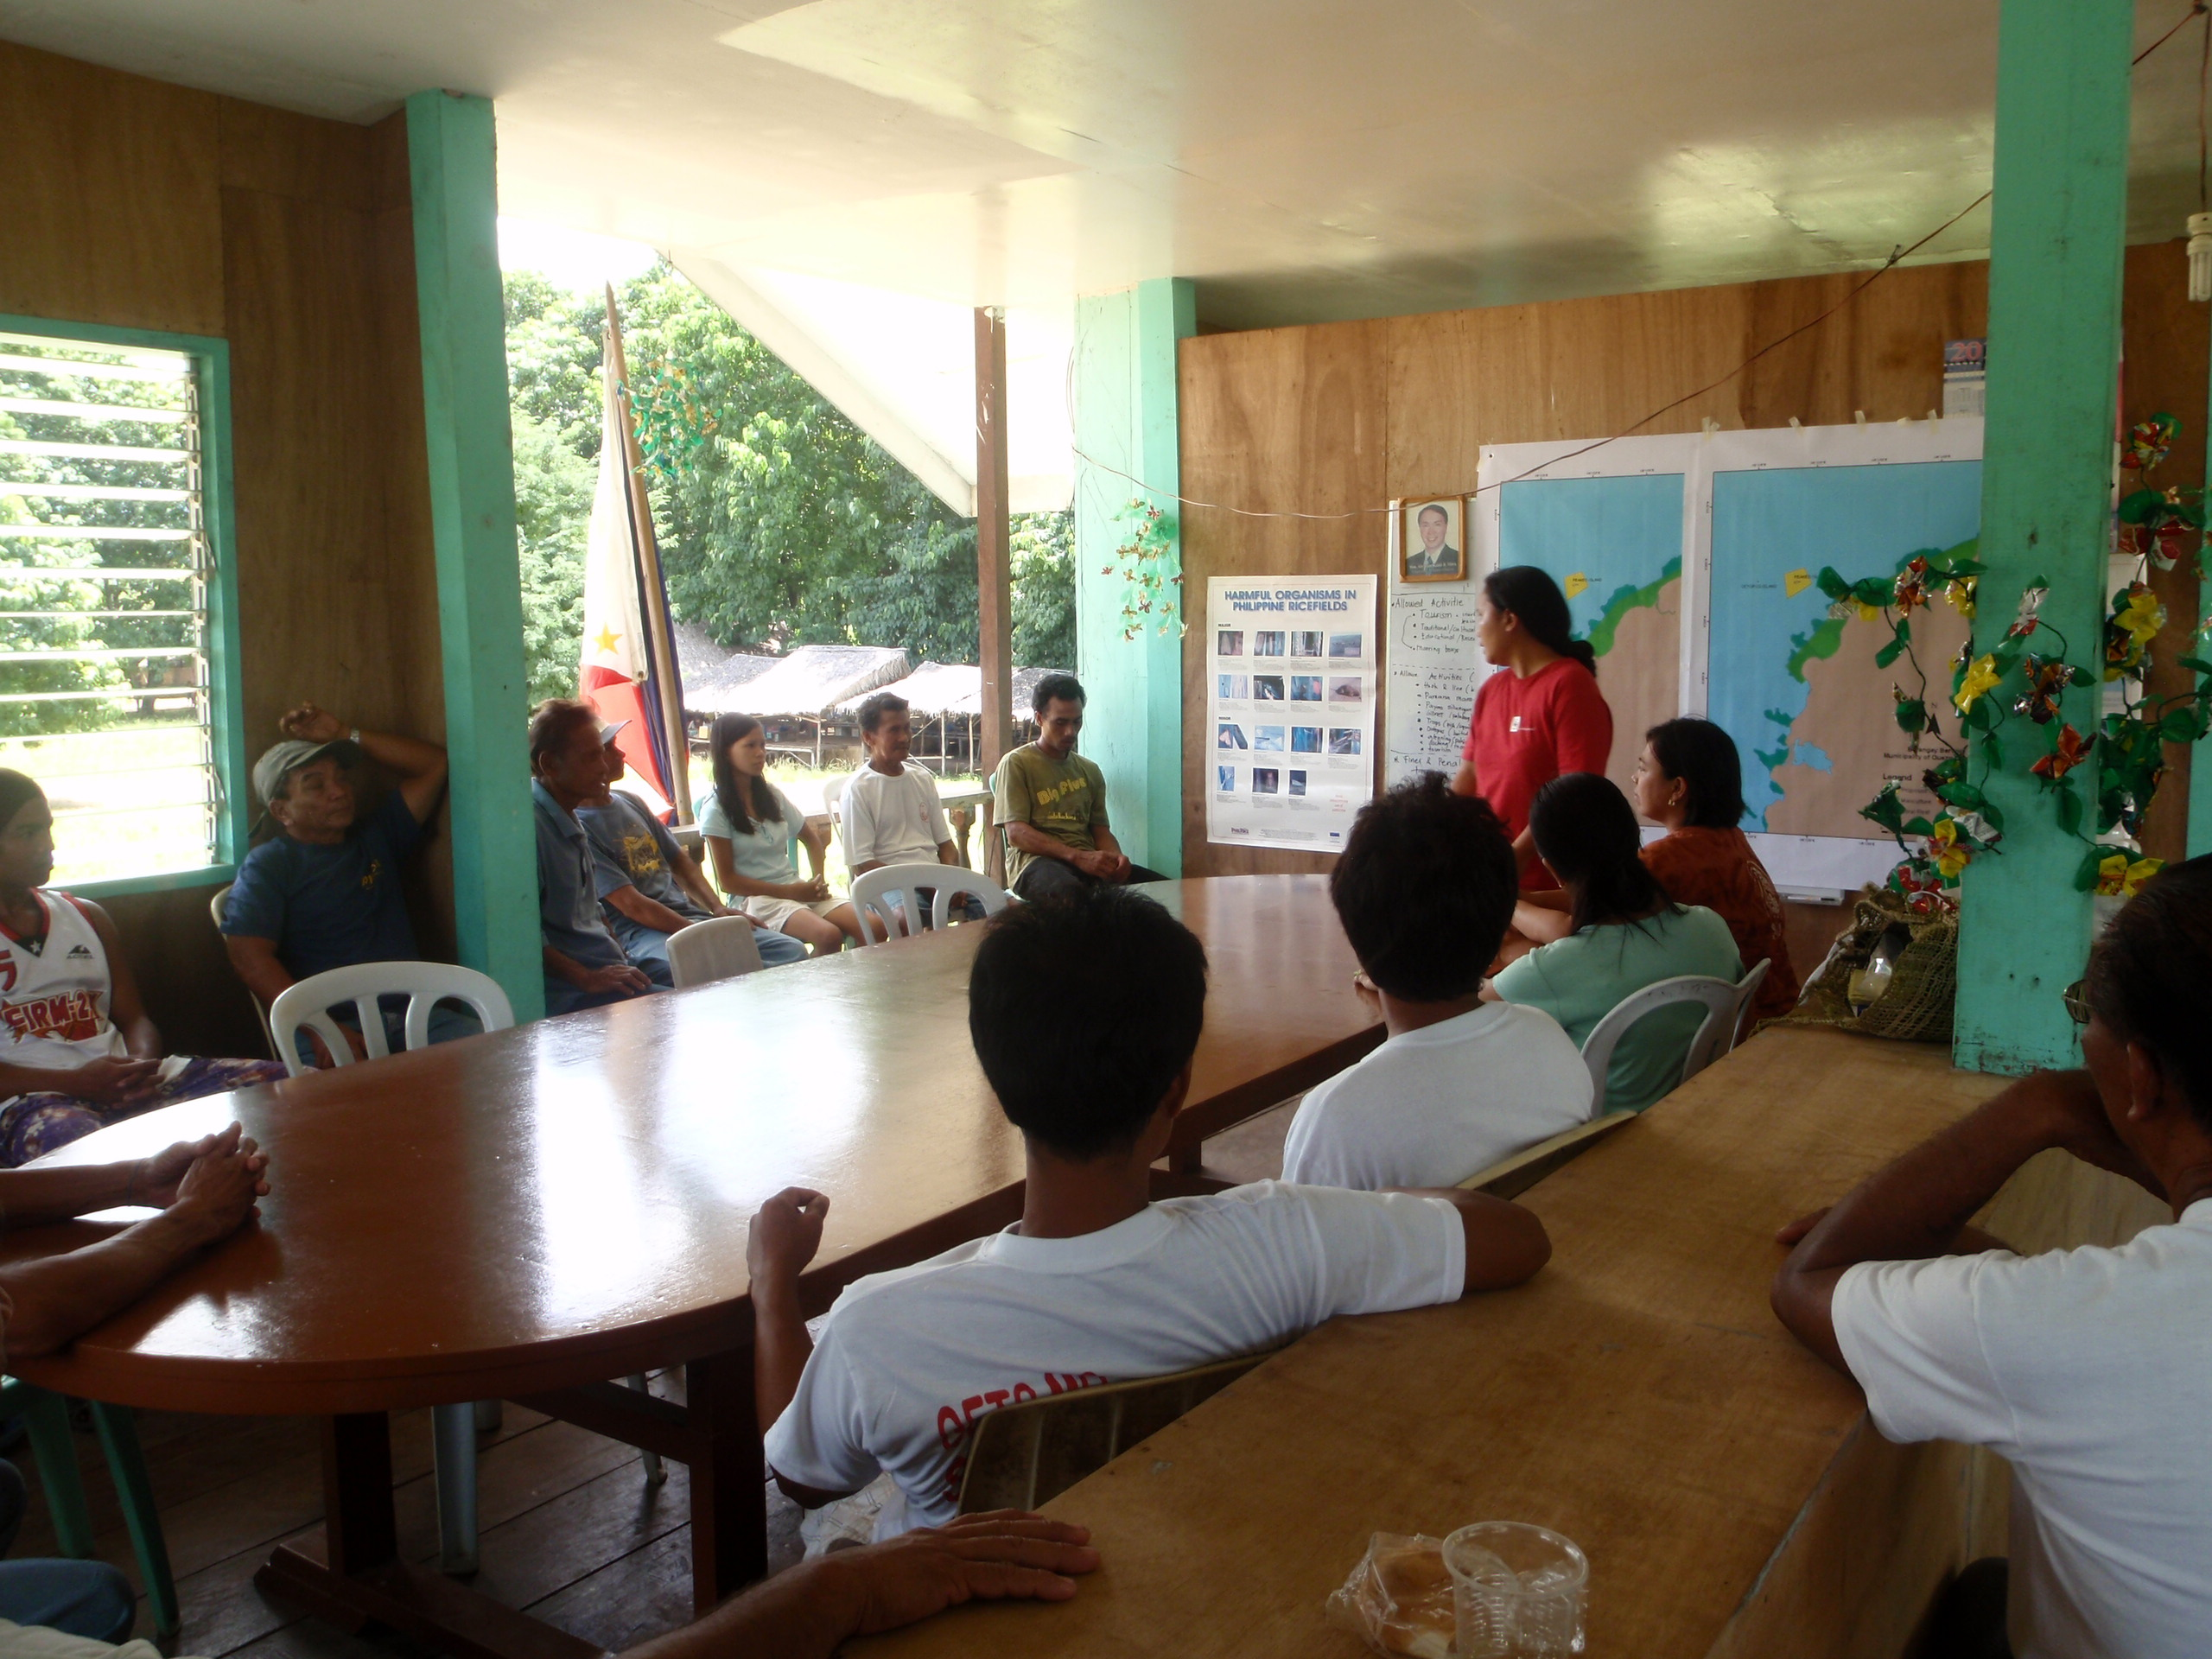
2. Sustainability Planning
Presentation and validation of study results
Community and LGU meetings
Planning workshops

Slide 10
3. Policy enhancement / development
  LRF ‘Chain of Custody” and Value Chain Analysis
  Incorporation of LRF Sustainability Plan to the Comprehensive Municipal Fishery Ordinance of Taytay
  Annual Revenue Projection in support of AIP
  Mapping and demarcation of proposed MPAs

Slide 11
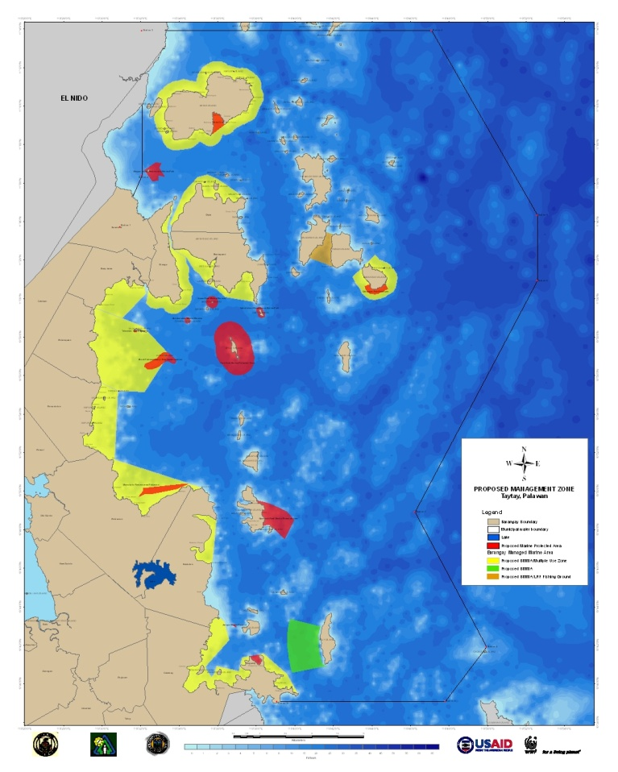
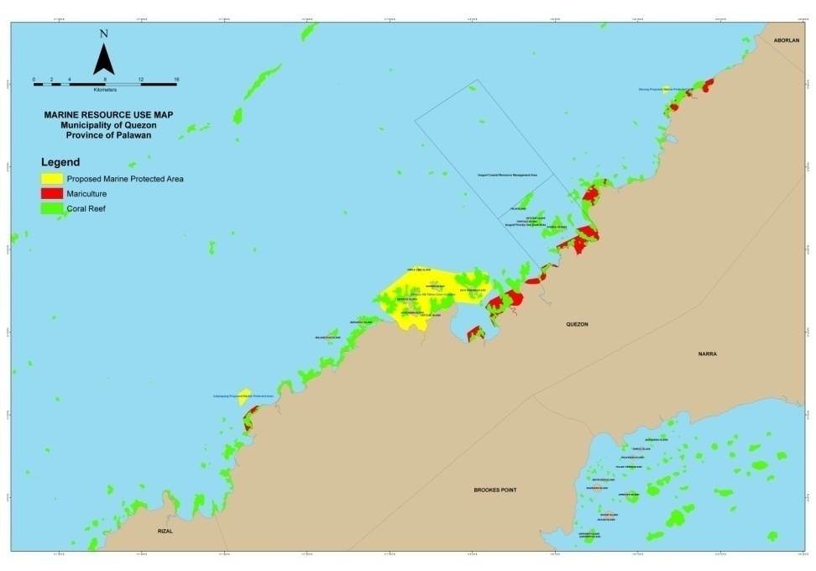

Slide 12
Mapped sites | Area (hectares)
Proposed MPAs / Sanctuaries | 3,924.89
Existing MPAs / Sanctuaries | 18,645.05
Seaweeds and fish cages | 9,831.84
Marine lease concession | 13,647.35
Taytay Bay municipal waters | 196,862.02

Slide 13
Projected Annual Revenue from Fishery Sector based on Studies and Existing Policies
Item | Details | Volume / Quantity / Area per 2009 inventory | Unit Amount (minimum) | total amount per year
Rental Fee / User Fees | Seaweeds / Fish Cage / Fish Corral | 9,831,200 sqm | Php.10/sqm | 9,831,200.00
 | Pearl Farms | 136,473.500 has | 700.00 per hectare per year | 9,553,145.00
Regulatory Fees | Fishing Boat Registration | 1,616 units | Php640/boat/ year | 1,034,240.00
 | Fisherfolk Registration | 2,622 pax | Php25/FF/year | 65,550.00
 | Fishing Gear Registration | 1,629 units | Php75./FG/yr | 122,175.00
Auxilliary Invoice | Fresh Fish | 337,153.800 kgs per month x 12 months | Php.50/kg | 2,022,918.00
 | Live Fish (suno) | 40,950 kg | Php10/kg | 409,500.00
 | Live fish (loba) | 17,830 kg | Php5./kg | 89,150.00
total projected revenue |  |  |  | 23,127,878.00
assumption: 20% collection efficiency |  |  |  | 4,625,575.60

Slide 14
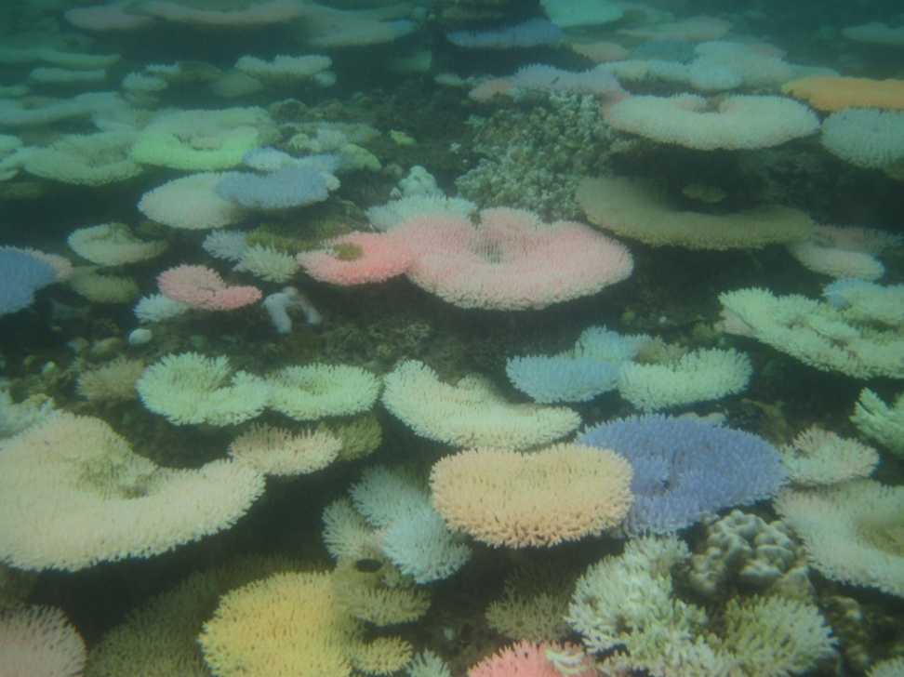
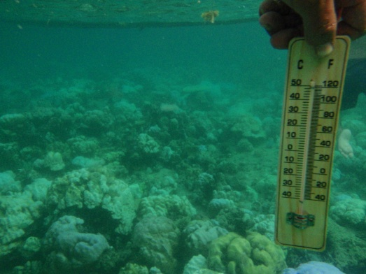
Way Forward
1. Stakeholders Capability Building:
  Fish Examiners Training
  Paralegal Training
  FARMC Strengthening
  Local Scientists training / mentoring
  CC Adaptation Plan for Taytay Bay
  Policy Development

Slide 15

Way Forward
2. Technical assistance to address concerns on trans-boundary fishing grounds for LRF
21 kms

Slide 16
Way Forward
3. Technical assistance to LGU to address concerns re submerged and sustenance fish cager
Fast Facts:
sustenance cagers comprise 66% of total # of LRF cagers in 2008; expected to increase by 2010
Catches (intentionally and non-intentionally) undersized groupers for fattening in grow-out cages
Submerged to depths of 20 or more meters; uses hookah for maintenance and are hard to monitor

Slide 17
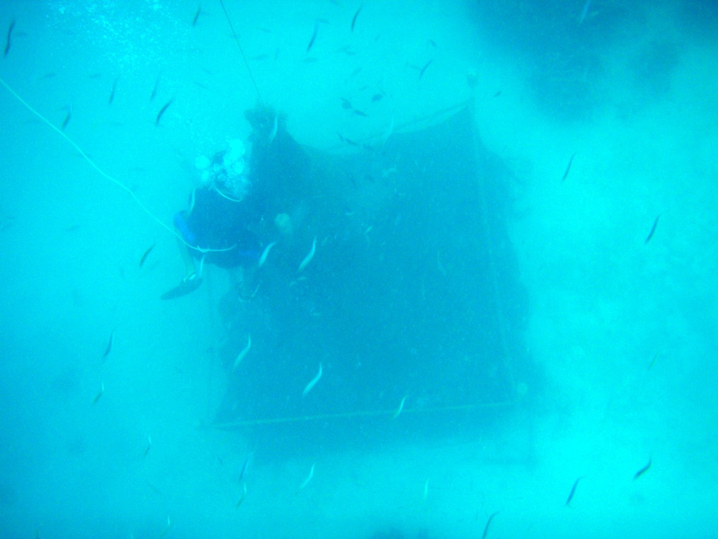
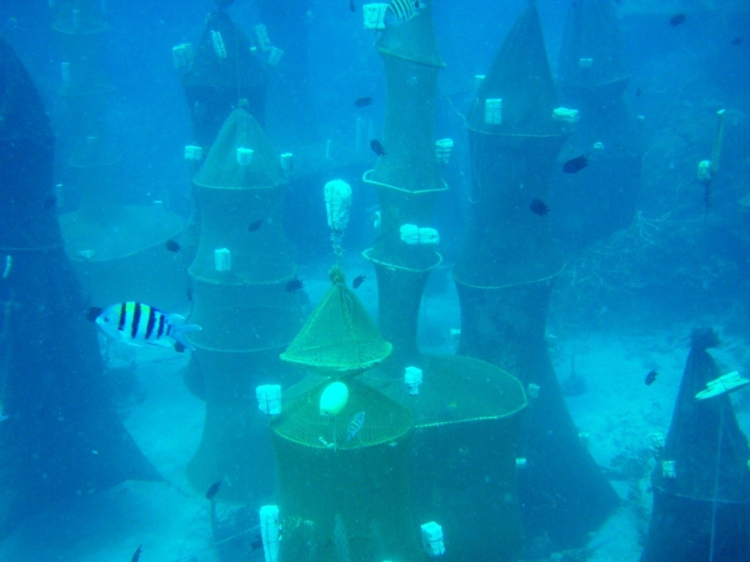

Slide 18

Sample site:
PALY ISLAND, TAYTAY
year | LRF cages | LRF cagers
2008 | 408 | 225
2010 | 1,116 | 360

Slide 19
Way Forward
4. Research
  1-year study in the determination of CPUE, fecundity and spawning seasonality of P. leopardus in Quezon and Taytay. (on-going)
  Database enhancement (bio-physical, socio-economic-cultural)

Slide 20
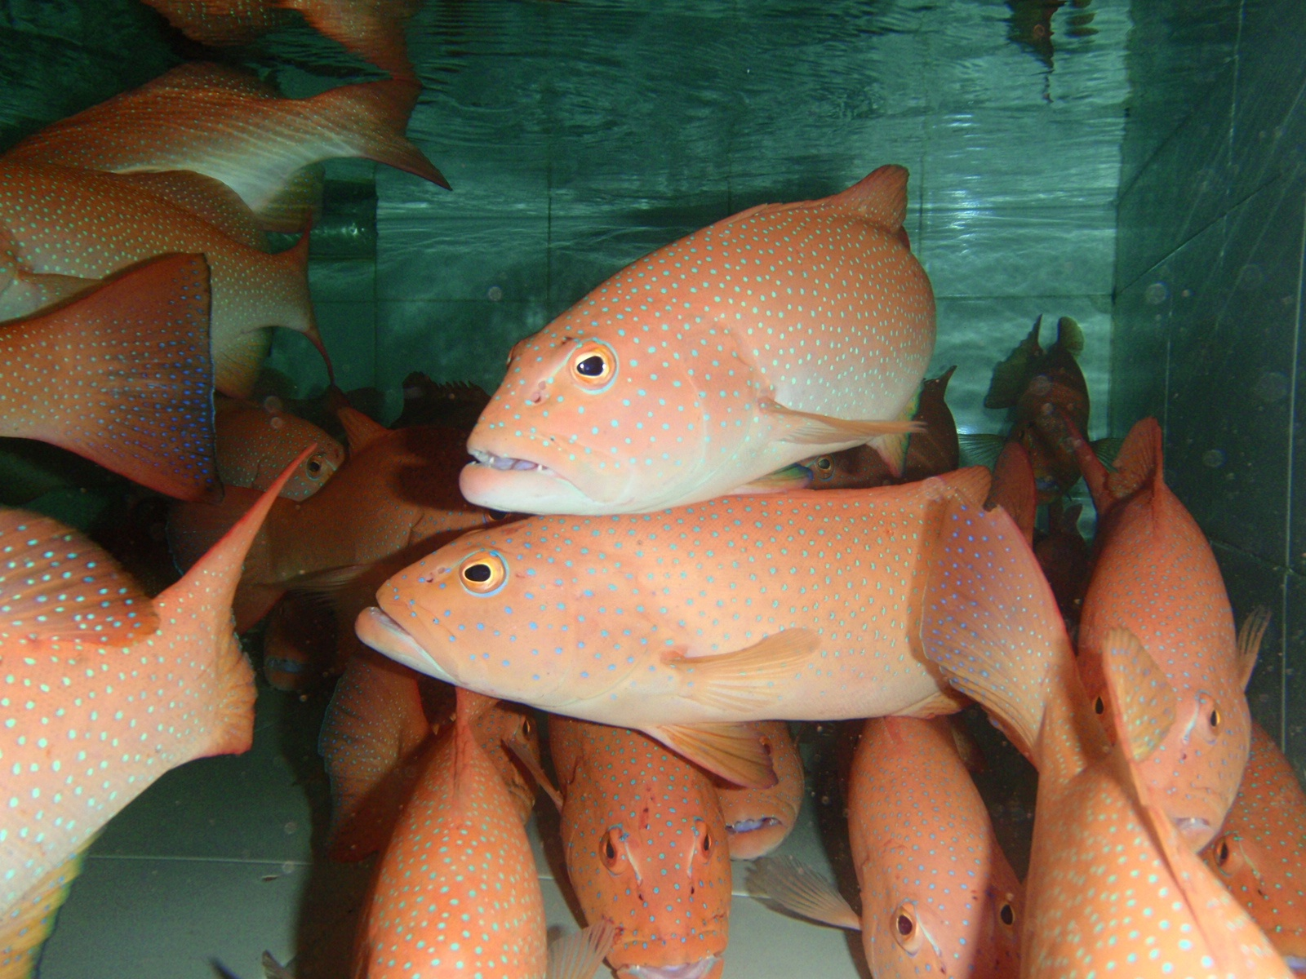
Thank you!

