Slide 1
The Live Reef Food Fish Trade (LRFFT)
A supply chain review and breakout discussion for the APEC-WWF workshop
Bali, Indonesia
March 1-3, 2011
Notes:
ME – CEA
We
Purpose of this session is to summarize what is currently published or conjectured about the LRFFT, and to use the collective wisdom in this room to update it
Process
I apologize in advance if I’ve made egregious errors – represents about 2 weeks of work; this is compounded by the fact that the data is absent, and where this is data it is often contradictory

Slide 2
Objective
  Why do we care?
    Industry structure is critical in informing any efforts to influence the future trajectory of the industry (e.g. certification, fishery reform projects, investment standards, major buyer engagement, voluntary standards, trade networks, trade restrictions, etc.).
  Objectives for this session:
    Test the current synthesis of the LRFFT supply chain
    Update estimates of total industry value and volume
    Fill in the major gaps around end markets and industry concentration
  Structure
    Overview of trade as we know it (20 min)
    Rough description of current supply chain and value chains (10 min)
    Breakout groups to discuss the findings and suggest revisions, additions, changes, etc. (60 min): If appropriate, may break into groups with regional foci: Indonesia, Philippines, Malaysia, and end markets (Hong Kong, China).
Notes:
“The LRFF trade is a secretive and collusive industry…”
“Current margins are based on limited empirical evidence, with these margins adjustable to enable exploration…”

Slide 3
Size of the trade: Previous reviews suggested that the global LRFF market was worth approximately $800M to $1B at the point of sale; with 30,000 tons of LRFF traded globally per year from 1999-2002
Value/Volume
Reference
Assumptions and Methodology
Sonny Koeshendrajana (2006), citing Sadovy (2003)
Volume estimate from 2002; provided by CSD and AFCD data – CSD represents mainly imports by air, and AFCD does not identify source country for import data
Price used to determine market value was approximately $27 per kg (roughly the average retail price of select species in March 2003)
Only includes officially reported import data
Official Hong Kong imports of 13,000 tons in 2002; worth an estimated $350M at final point of sale
Total HK imports may have been 18,000 tons annually, if we estimate unreported imports, worth $450-500M under the same assumptions
Geoffrey Muldoon, Peter Scott, APEC (2005), citing Sadovy (2003)
Uses the above assumptions and methodology but includes an estimate of unreported imports; Assumes that Hong Kong-flagged fishing vessels only declare half of their imports of LRFF
Pomeroy, et. al. (2005) citing McGilvray and Chan (2001)
Padilla et. al. (2003) citing $1 billion from Pratt et. al. (2000)
Sadovy (2003) extrapolating $810 million
Uses the above assumptions to estimate world market value of live reef food fish.
Assumes that Hong Kong, China is 60% of the market, including re-exports
Global trade estimated at 30,000 tons, worth $810M-$1B annually, assuming Hong Kong is 60% of the market
Notes:
“The LRFF trade is a secretive and collusive industry…”
“Current margins are based on limited empirical evidence, with these margins adjustable to enable exploration…”

Slide 4
Updating the figures for volume and retail value using the same assumptions suggests that the LRFF market is worth closer to US $2B in current dollars
Hong Kong imported 10,630 tons of live reef food fish in the year 2009 (WWF analysis of CSD and AFCD data, 2009)
This factors in unreported landings via HK-flagged fishing vessels (WWF analysis of CSD and AFCD data, 2009)
The estimate that Hong represents 60% of the live reef food fish market remains unchanged (Sadovy et. al. 2003)
Current retail prices in Hong Kong are estimated at roughly $96 per kg (FMO wholesale price data, and IMA mark-up estimate)
Includes imports via air – 64%
Includes imports via fishing vessel – 36%
AFCD historically assumed that documented imports via shipping vessels are underreported by about 50%
We assume that the total of 3,200 tons of imports via fishing vessels, includes an estimate of unreported landings via fishing vessels (WWF analysis of CSD and AFCD data)
According to the Fish Marketing Organization, the Hong Kong wholesale price for LRFF averaged $55 per kg in 2009
IMA estimated that the markup between wholesale and retail prices in Hong Kong was 74% between 1999 and 2003.
Validation: WWF reports that current Hong Kong retail prices range between HK$400 and HK$1,200 depending on species
((10,630) / 0.60) tons x $96 x 1,000 kg per ton = ~ $2 billion
17,716 tons total

Slide 5
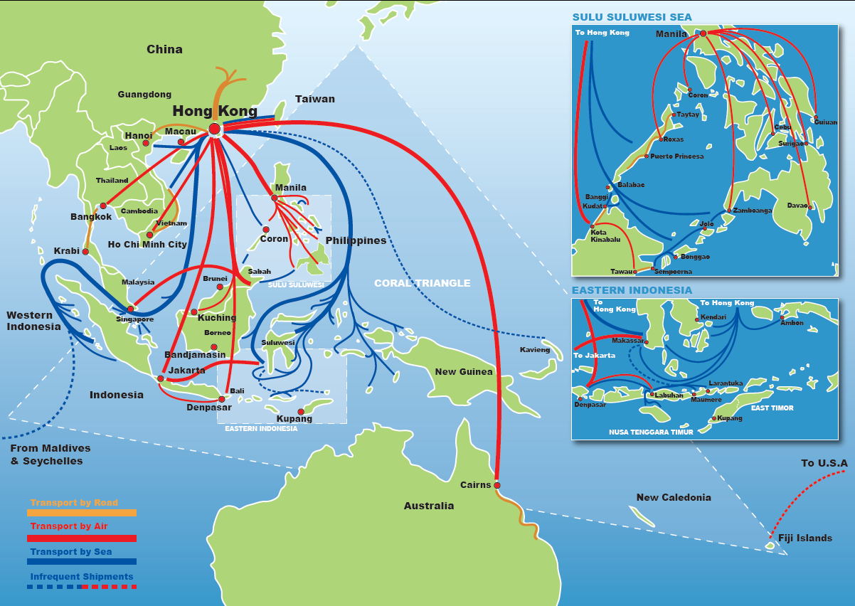
The LRFFT is most heavily concentrated in the coral triangle with end markets including Hong Kong and mainland China, but we don’t have numbers to estimate the size of each flow
Source: WWF

Slide 6
UN COMTRADE also collect data on live fish trade. However, it is not specific enough to gauge trends in the LRFFT.
Exports of live fish over time (USD)
Too inclusive: Includes trade of ornamental live fish, and non-reef live fish such as eel
Not necessarily accurate: Does not include officially unreported trade
Imports of live fish over time (USD)

Slide 7
According to Hong Kong’s CSD, imports of live reef food fish by air were highest from Philippines, Indonesia and Thailand
% air imports by volume and country of origin in year 2009
Total = 6,854 tons
Source: Hong Kong Census & Statistics Department
Other category includes: Vietnam, Kiribati, India, Cambodia, Canada, Brunei, Turkey, Togo, New Zealand, Papua New Guinea, Sri Lanka, Myanmar, France, Singapore

Slide 8
In 2009, reported landings by fishing vessels indicated that Indonesia and Malaysia were the largest suppliers to Hong Kong by sea
Share of volume of Hong Kong’s imports by source country in 2009 (%)
Total = 1,893 tons
Data from Agriculture, Fisheries and Conservation Department for the year 2009
This data represents estimates from information provided voluntarily by nine traders shipping live marine fish into Hong Kong
These traders’ imports only represent about 15% of Hong Kong’s total live marine fish imports
*Tiger grouper, leopard coraltrout, green grouper, flowery grouper, brown-spotted grouper, roving spotted grouper, barred cheek coral trout, speckled blue grouper, spotted coraltrout, giant grouper, mangrove snapper, high finned grouper, other wrasses and parrotfishes

Slide 9
If we double landings by fishing vessels and include air shipments landings, two-thirds of the overall Hong Kong imports come from Indonesia, the Philippines, and Malaysia.
Share of volume of Hong Kong’s total imports by source country in 2009 (%)
Total = 10.500 tons
Data from Agriculture, Fisheries and Conservation Department and CSD for the year 2009

Slide 10
The Philippines has traditionally been the largest exporter of live reef food fish in the world. In 2006, the Philippines officially exported approximately 7,000 tons of live grouper.
Exports of live grouper from Philippines over time (tons)
In 2006, the Philippines exported approximately 7,000 tons of live grouper. We do not know what fraction of that fish ended up in the Hong Kong market.
Current official HK imports of fish from the Philippines are closer to 2,000 mt.
We have no estimates for unreported exports from the Philippines, e.g. those through Malaysia.
Tons
Year
Philippines exports vs. Hong Kong imports in 2006 (tons)
Tons
Source: Bureau of Agricultural Statistics, Philippines; Sadovy, et. al. 2003; The Agriculture, Fisheries and Conservation Department of the Hong Kong SAR Government;
Notes:
http://countrystat.bas.gov.ph/index.asp?cont=selection&pageid=pxweb/dialog/varval.asp&ma=E50TDVAE&path=pxweb/database/main/MEGA/&lang=1

Slide 11
Malaysia officially exports 2,000 tons of LRFF. Unreported trade may be substantially larger.
Share of Malaysia’s exports that are legal vs. illegal
The amount of live reef food fish being legally exported by Malaysia is around 2,000 metric tons annually, of which 85% comes from Sabah.
Malaysia exports may include a substantial quantity of unreported live reef food fish via boat, estimated by one industry expert at 8,000 tons per year.
Tons
Share of Malaysia’s exports coming from Sabah
Tons
Source: Sadovy, et. al. 2003; The Agriculture, Fisheries and Conservation Department of the Hong Kong SAR Government; Expert opinion on Malaysian trade of LRFF
Notes:
Irwin Wong interview notes

Slide 12
Indonesia was one of the largest exporters of live reef food fish, but official exports peaked in 1995
Exports of live reef food fish from Indonesia over time (tons)
Tons
In 2005, Indonesia officially exported approximately 1,280 tons of live reef food fish. Today, Hong Kong alone now officially records about 3,000 metric tons.
We have no estimates for unreported exports from Indonesia or direct exports to non-Hong Kong destinations..
Year
Indonesia’s exports vs. Hong Kong’s imports in 2005 (tons)
Tons
Sources: WWF Trade Scoping Study, 2007.; Indonesian Directorate General of Fisheries

Slide 13
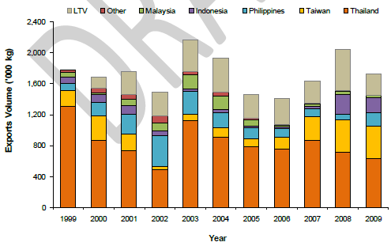
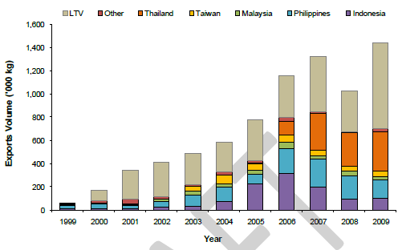
Thailand produced about 3,105 tons of grouper through aquaculture in 2008, and is a significant exporter mostly of green grouper and tiger grouper
Hong Kong imports of tiger grouper over time by air
and by fishing vessel* (‘000 kg)
Production of grouper through aquaculture over time (tons)
Tons
Hong Kong imports of green grouper over time by air
and by fishing vessel* (‘000 kg)
Year
Source: WWF Coral Triangle Program, Workshop Report, 2009.
Source: FAO Global Aquaculture Production Online Query Results

Slide 14
Taiwan farms nearly 17,000 tons of farmed grouper each year, a quarter of which is exported
Production of grouper through aquaculture over time (tons)
Taiwan’s share of global grouper aquaculture in 2007
Total = $205 million
Tons
NA
Year
Average production and export of live grouper in Taiwan
We estimate that Taiwan consumes about three quarters of its farmed grouper production domestically
Tons
Sources: Rimmer et. al., “Aquaculture of groupers in Asia and the Pacific”, 2005.; Fisheries Agency, Taiwan; Chang, Meg, “Groupers help boost nation’s aquaculture” Taiwan Today, 2009.

Slide 15
Slides for break-out group discussion

Slide 16
But what are the actual numbers? Questions for the breakout session, Markets Group
Based on your professional judgment, what share of the global LRFFT passes through the Hong Kong market, including fish that is re-exported (e.g. 60%? More? Less? What is a reasonable range)? ___________%
What fraction of Hong Kong’s imports do we think are re-exported (0-25% 25-50%? 50-75%? 75-100%)? ___________%
If you had to estimate, what are the largest end markets for LRFF? What fraction of the global LRFFT ends up in these different end markets?
  Hong Kong ______________%
  China ______________%
  Taiwan ______________%
  Singapore ______________%
  Japan ______________%
    Others? ______________%
To what extent do you trust the data reported to the Hong Kong authorities? In particular, do we feel confident in the estimates of landings by fishing vessels (just 3,000 tons per year?)
Is $100/kg a reasonable estimate for a retail price for LRF? Too low? Too high? What would a better estimate be? ___________
Do any producing countries have a substantial domestic consumption of LRFF? Malaysia? Indonesia?

Slide 17
But what are the actual numbers? Questions for the breakout session, Markets Group
How would describe the structure of the supply chain within Hong Kong? How many importers, wholesalers, distributors, or retailers are there?
Does the Hong Kong Chamber play a role in organizing this community?
Is there much vertical integration in the industry? Are there patronage systems still in play?
Who has the power in the supply chain? Who makes the most profit (but volume or value)?

Slide 18
Philippines Breakout Group: a draft supply diagram?
~44 PhP = $1
Retailers
Wholesalers
Hong Kong Importers
Other end markets
Commercial planes
4,200 tons/yr?
2,800 tons/yr?
Manila-based Exporters
Charter planes
No longer in operation
Buying
stations
Yuki Aquamarine
Kos Aquamarine
Great Ocean (Manila-based)
Kenneth Aquamarine (Manila-based)
Sea Dragon (Manila-based)
Cage Operators
Add PhP100 per fish
Financiers
Add PhP20 per fish
Middlemen
Sometimes fish sold exclusively in exchange for gear/loans
IUU fish to Malaysia and carrier vessels (5,000 tons?)
~3,000 Fishers; 55% of production in Palawan
Source: Padilla et. al. 2003 Pg. 26-27; LRFF workshop 1 Pg. 46 (IMA numbers); Pomeroy Pg. 86; 2005 workshop_2_Pg. 146

Slide 19
Philippines Breakout Group: how you make this more accurate?
Price?
Retailers
Price?
Wholesalers
Price?
Hong Kong Importers
Destinations???
Commercial planes (main companies?
Volume?
Price?
Volume?
Manila-based Exporters (Number?)
Charter planes
Price?
No longer in operation
Yuki Aquamarine
Kos Aquamarine
Great Ocean (Manila-based)
Kenneth Aquamarine (Manila-based)
Sea Dragon (Manila-based)
Cage Operators
Price?
Volumes?
AMO/Financiers (Number?)
Price?
Volume?
Middlemen (Number?)
IUU fish to Malaysia and carrier vessels (quantity? Price?)
Volume?
Price?
Volume?
Fishers (Number?) (Share of production in Palawan?)

Slide 20
Questions for the Philippines Breakout Group
Can we estimate price or volume of LRFF at any step of the chain?
How many people/businesses operate at each step of the chain? Is there much consolidations?
How much production is moved to Malaysia? How do we know?
What fraction of exports from the Philippines do we think do not go to Hong Kong? E.g. what share or amount do we think is shipped directly to
  China ______________%
  Taiwan ______________%
  Singapore ______________%
  Japan ______________%
    Others? ______________%
To what extent do you trust the data reported to the official Philippines export data?
Is there any domestic consumption of LRFF within the Philippines?
Is there much vertical integration in the industry? Are there patronage systems still in play?
Who has the power in the supply chain?
Who makes the most profit?

Slide 21
Malaysia Breakout Group: a draft supply diagram
$45/kg in 2003 (IMA)
Retailers
~160 ringgits/kg or $53/kg
$25/kg in 2003 (IMA)
Wholesalers
~120 ringgits/kg or $40/kg
HK flagged vessels
Hong Kong
Shanghai
Singapore, Taiwan (buying broodstock)
Via commercial air freight (Cathay Pacific, Malaysia Airlines, South China Air)
~80-85%
~15-20%
Just 1-2 shipments/yr
Kota Kinabalu exporters (~10 major exporters, but 1000s of permits)
~90 ringgits/kg or $30/kg
~2,000 tons per year
IUU on carrier vessels: ~3-4X volume of legal exports
Lorries in Kudat transfer to Kota Kinabalu (“thousands of operators”)
~70 ringgits/kg or $23/kg
Live fish carriers transfer to Kudat
Holding cage operators along shoreline (~300 operators of various scale)
~60 ringgits/kg or $20/kg
1,000+ fishers in Sabah and Palawan (~60% of Sabah fish caught in Philippines)

Slide 22
Malaysia Breakout Group: How would you make this more accurate?
Price?
Retailers
Price?
Wholesalers
Price?
HK flagged vessels
Hong Kong
Shanghai
Singapore, Taiwan (buying broodstock)
Via commercial air freight (Cathay Pacific, Malaysia Airlines, South China Air)
Volume?
Volume?
Volume?
Kota Kinabalu exporters (NUMBER?)
Price?
Volume?
IUU on carrier vessels: ~3-4X volume of legal exports
Lorries in Kudat transfer to Kota Kinabalu (NUMBER?)
Price?
Volume?
Live fish carriers transfer to Kudat (NUMBER?)
Price?
Volume?
Holding cage operators along shoreline (NUMBER?)
Price?
Fishermen in Sabah and Palawan (NUMBER?) (% of Sabah fish caught in Philippines)

Slide 23
Questions for the Malaysia Breakout Group
Are the estimates of volume, value, and number of people at each step of the supply chain accurate?
In particular, what do we think of the unreported export estimates?
What fraction of exports from Malaysia do not go to Hong Kong? E.g. what share or amount do we think is shipped directly to
  China ______________%
  Taiwan ______________%
  Singapore ______________%
  Japan ______________%
    Others? ______________%
To what extent do you trust the data reported to the official Malaysia export data?
Is there any domestic consumption of LRFF within Malaysia? Any way to estimate it?
Is there much vertical integration in the industry? Are there patronage systems still in play?
Who has the power in the supply chain?
Who makes the most profit?

Slide 24
Indonesia Breakout Group: Starting from scratch…how to fill this in?
Price?
Retailers
Price?
Wholesalers (HK, elsewhere)
Hong Kong Importers
Other end markets
xx tons/yr?
Commercial planes
Xx tons/yr?
Exporters (Number?)
Charter planes
Buying
stations
Price?
Financiers (Number?)
Price?
Carrier vessel transport to Hong Kong (Price? Volume? # of vessels?)
Middlemen (Number?)
Price?
~xxx Fishers (xx% of production in Eastern Indonesia)
Source:

Slide 25
Questions for the Indonesia Breakout Group
Can we estimate price or volume of LRFF at any step of the chain?
How many people/businesses operate at each step of the chain? Is there much consolidations?
We’ve been told that production is moving toward Eastern Indonesia. Is this true? Any sense of the relative share of production coming from different parts of Indonesia?
What fraction of exports from Indonesia do we think does not go to Hong Kong? E.g. what share or amount do we think is shipped directly to
  China ______________%
  Taiwan ______________%
  Singapore ______________%
  Japan ______________%
    Others? ______________%
To what extent do you trust the data reported to the official Indonesia export data?
Is there any domestic consumption of LRFF within Indonesia?
Is there much vertical integration in the industry? Are there patronage systems still in play?
Who has the power in the supply chain?
Who makes the most profit?

Slide 26
SLIDES FOR THE AFTERNOON SESSION

Slide 27
Generalized value chain of live reef food fish trade
X-Y%
= estimated proportion of total value-added retained by intermediary
Consumer
(X-Y%)
= percentage of total trade volume
30-35%
Retailer
Distributor
10-15%
Wholesaler
5-10%
Importer
10-30%
Exporter
Stopover
Stopover
1st/2nd buyer
1st buyer
15-25%
(15-40%)
(0-35%)
(50-70%)
Aquaculture (10-15%)
Marine fishers (85-90%)
5-15%
Source: Sadovy et. al. 2003 Pgs. 3-4; LRFF workshop 2 Pg. 97 – Muldoon, Johnston – hypothetical boxed values

Slide 28
Generalized value chain?
Do these estimates seem right/wrong for the trade as you know it?
Who makes the most profit in this supply chain? The exporter? The retailer? Who makes the least profit?
_________________________________________
Who has the most power in this supply chain?
_________________________________________
Who in this supply chain has the most responsibility to ensure that the LRFFT is sustainable?
_________________________________________
What steps could each link in the supply chain take to ensure a more sustainable LRFFT?
_________________________________________
Consumer
30-35%
Retailer
X-Y%
= estimated proportion of total value-added retained by intermediary
10-15%
Wholesaler
5-10%
Importer
10-30%
Exporter
1st/2nd buyer
15-25%
Marine fishers
5-15%

Slide 29
ADDITIONAL SLIDES

Slide 30
“Mainland China, Thailand, Indonesia, Malaysia, the Philippines, Australia and Vietnam have historically been the major exporters of wild-caught reef fish as well as wild-caught fry and fingerlings for grow-out, accounting for approximately 95% of all recorded imports into Hong Kong.”
Source: Sadovy 2003 pg. 6; Trade scoping study 2007 pg. 9
Notes:
Trade scoping study, 2007

Slide 31
Although the live food fish sector is a small portion of fish trade, the high premium for live fish makes this market highly lucrative relative to the fresh fish market
Average retail prices (March 2003) of dead and live reef food fish in Hong Kong, China (USD/kg)
Source: Sadovy, 2003

Slide 32
The live reef food fish trade has expanded to include many source countries; global aquaculture production of groupers is now in excess of the LRFFT, though most destined for the fresh fish market
Primary source countries:
Indonesia,
Philippines
Australia
PRC
Malaysia
Thailand
Viet Nam
Contributing source countries:
Fiji Islands
Maldives
Marshall Islands
Papua New Guinea (PNG), Seychelles
Singapore
Solomon Islands
Supply of live reef food fish as of 2005
Global aquaculture production in 2007
= Wild capture
= Aquaculture from wild seed
= Full cycle mariculture
tons
Pomeroy et. al. “Evaluation of Policy Options for the Live Reef Food Fish Trade: Focus on Calamianes Islands and Palawan Province, Philippines, with Implications for National Policy”, Pg. 13, 2005.

Slide 33
Recorded import volumes into Hong Kong have been relatively constant or increasing, though down from the 1990s.
Volume of Hong Kong LRFF imports over time
Data from Agriculture, Fisheries and Conservation Department – Hong Kong, as of Feb. 20, 2011
This data represents live reef food fish . No fish fry or ornamental fish are included
The volume data includes imports by air and by fishing vessels.
Value data reflects import price (Vehicle Price + Shipping freight + Insurance Cost), not wholesale price, of air imports only
Tons
Year
Value of Hong Kong LRFF air imports over time
Thousands of US$
Year
Sources: The Agriculture, Fisheries and Conservation Department of the Hong Kong SAR Government; Hong Kong Census & Statistics; WWF

Slide 34
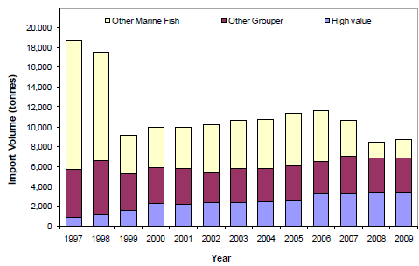
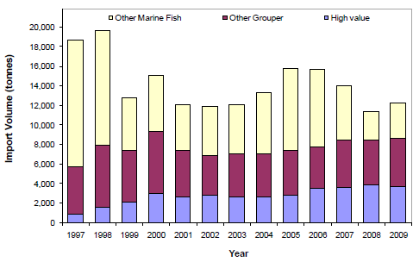
WWF used CSD and AFCD data to estimate the difference between imports by air and imports by fishing vessel
Hong Kong import volume by air transport over time (tons)
% imports by air and by fishing vessel in 2009
Total = 10,630 tons
Hong Kong import volume by air transport and fishing vessel over time (tons)
Source: WWF Coral Triangle Program, Hong Kong Workshop Report, 2009.

Slide 35
At least 59 species are traded in the live reef food fish market
Hong Kong annual imports of select species in terms of value (US$)
Hong Kong Census and Statistics Department reported 6,830 tons of live fish trade in 2009. This is mostly LRFF imports via air. The majority of Hong Kong’s imports are leopard coraltrout.
Hundreds of thousands of US$
Year
Hong Kong annual imports of select species in terms of volume (tons)
Tons
Year
Sources: Pomeroy, et. al. 2005, Pg. 14; Hong Kong Census and Statistics Department

Slide 36
Composition of Hong Kong imports – leopard coral trout or leopard coral grouper is the most popular live reef food fish species consumed
% breakdown of total Hong Kong import volume by species as of 1999
% breakdown of sample of Hong Kong import volume by species as of 2009
Total = 24,000 tons
Sample total = 6,830 tons
Source: http://wwwx.spc.int/coastfish/News/lrf/7/LRF7-07.htm - Appendix, Interviews with 39 out of 114 companies that trade live fish in Hong Kong; Hong Kong Census and Statistics Department

Slide 37
Leopard coraltrout has been the most significant species by value for air imports of LRFF into Hong Kong
Thousands of US$
Year
Sources: The Agriculture, Fisheries and Conservation Department of the Hong Kong SAR Government; Hong Kong Census & Statistics; WWF

Slide 38
Taiwan consumes a large volume of live reef fish, but most of it comes from domestic aquaculture
Imports of live grouper and other live fish in 2009
Tons
Average production and export of live grouper in Taiwan
We estimate that Taiwan consumes about three quarters of its farmed grouper production domestically
Tons
Sources: Fisheries Agency, Taiwan; Chang, Meg, “Groupers help boost nation’s aquaculture” Taiwan Today, 2009.

Slide 39
Re-exports: Mainland China – Guangzhou Seafood Market
An estimate of Guangzhou Seafood Market’s turnover and composition as of 2006
Tons
In 2006, Hong Kong imported 15,700 tons of LRFF. Roughly half of that appears to have been re-exported to mainland PRC
Source - Johnson, B. (ed.) 2007. Economics and market analysis of the live reef-fish trade in the Asia–Pacific region. ACIAR Working Paper No. 63, 173 Pg. 83

Slide 40
Pricing: Value and Size of the reported LRFF trade in Hong Kong, according to the Fish Marketing Organization
Source: Fish Marketing Organization – Hong Kong

Slide 41
Pricing: The average Hong Kong wholesale price of LRF from 1999-2003 was HK$196/kg (~$25/kg); the average retail price was 74% higher at HK$336/kg (~$45/kg).
Source: Johnson, B. (ed.) 2007. Economics and market analysis of the live reef-fish trade in the Asia–Pacific region. ACIAR Working Paper No. 63, 173 pp. – using data from International Marine Alliance surveys of 726 restaurants in 18 districts of Hong Kong

Slide 42
Hong Kong Chamber: Members of the Hong Kong Chamber of Seafood Merchants are a significant portion of the LRFF trade
% of importers and wholesalers in the Chamber
% of distributors in the Chamber
Source: Interview with Irwin Wong, WWF

