Slide 1

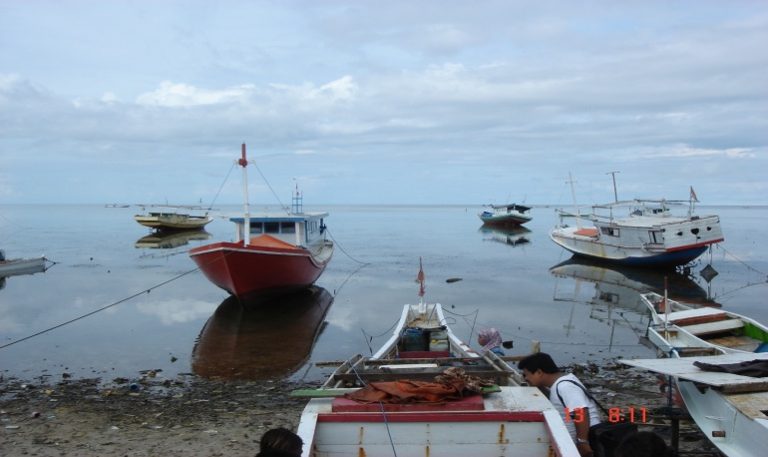
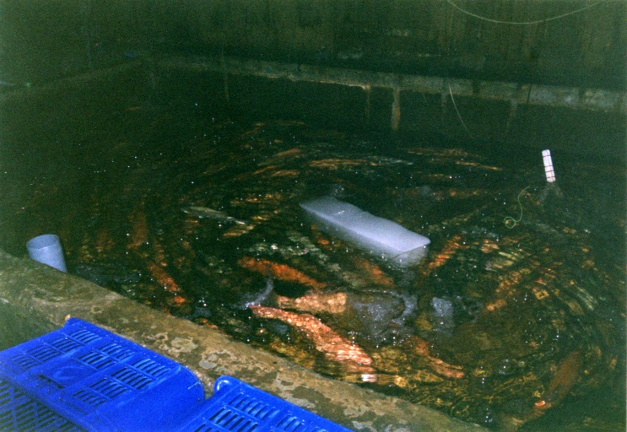
Managing across provincial, national and international jurisdictions: A case study of LRF-Fisheries in Indonesia
Akhmad Fauzi
Department of Resource & Environmental Economics
Bogor Agricultural University (IPB)

Slide 2
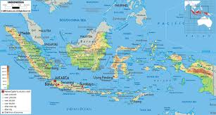
Brief overview of Indonesia LRFF
Indonesia is one of the key players in LRFFT to international market
Sustainable fisheries management, including LRF has become commitment of Indonesian Government
LRFF in Indonesia has been practiced for several decades, with different scale of economics and different geographical areas
Indonesian LRF faces enormous challenges from ecological, economical and social perspective
There has been a geographical shifting of Indonesian LRFF from dominated western part to eastern part of Indonesia

Slide 3
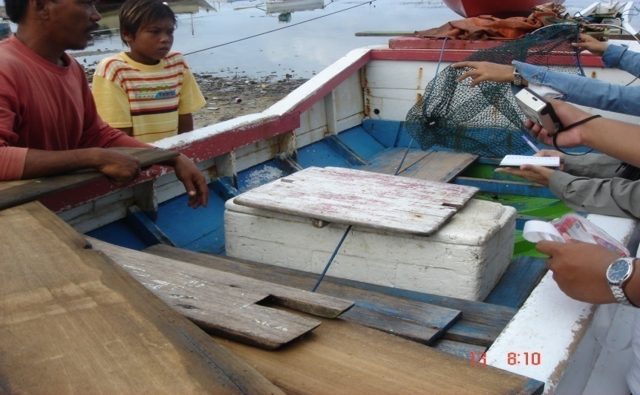
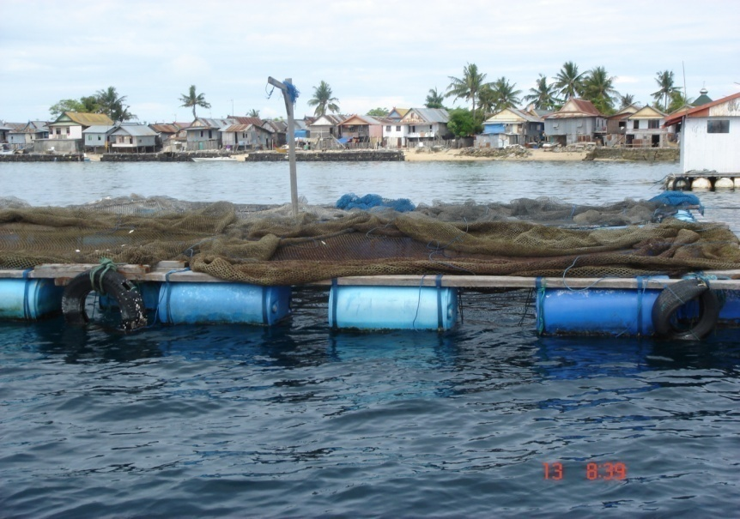
LRFF is a lucrative business involving various level of market chain
There has been concern over sustainability of Indonesia’s LRFF due to destructive fishing practices and IUU fishing
To some extent, benefits received from LRF are outweighted by the destruction of coral reef
Complexity in managing the fishery due to different jurisdiction

Slide 4
Fisheries Policy: from centralization to decentralization
PRE-1999
Centralization
1999
Post-1999
Decentralization
Central government had full authorities to manage the fisheries
Growth oriented policy driven
Priority was given to increase export of high value species such as shrimp and tuna
Old Fisheries Act 1985
Soeharto stepped down
Reforms of government initiated
State of “vacuum” in fisheries management
Decentralization era
35 of 41 authorities, including managing natural resources are under local government control
Conflict of jurisdiction of fisheries over access to and control of resources
occurred more often
New Fisheries Act 31/2004 -> 45/2009

Slide 5

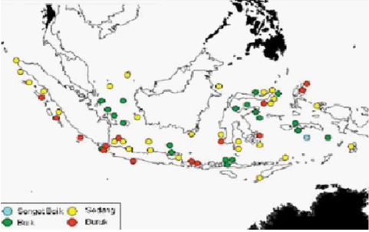
Overall challenges of Indonesia LRFF
Most coral reefs have been damaged (especially in the western part)
“myopic decision” by fisheries due to limited livelihood in coastal areas
MRV mechanism for LRFF in Indonesia is not yet available (e.g what is overfishing indicator for LRFF?, how data support this claim?)
A comprehensive Policy for is not yet available
LRFF is not priorities especially at regional, local levels.
Challenges to fulfill EAFM
Source : LIPI, 2005

Slide 6



Challenges in managing LRFF across provincial, national and international : Multi flows of input- output data
Mostly local/regional
jurisdiction
Mostly national
jurisdiction
nat
Data on numer of vessels. Fish caught
National/
International
jurisdiction
Unrealibale reporting
Fishers,
Traders
Fisheries Agencies
At local levels,
Regionals and
national
Statistically
Unrecoginzed
As LRF
Licenses
Data IUU Fishing
Are not obvious
Customs,
Other
agencies
Export market
Broken link
Export data
Difficulty on
Stock assessmnet
Broken link
Difficulty to pin-point LRF export

Slide 7
Typical Fisheries Status and the missing of LRF on the data
 | Fish Stock | Status
Area of fisheries | Demersal | M/O/F/U
 | Shrimp | M/O/F/U
 | Small Pelagics | M/O/F/U
 | Big Pelagics | M/O/F/U
Data regarding the resource
Data on export market
Type of fish | Volume of export | Value of export
Shrimp
Tuna
Seaweed
Ornamental fish
Others
Possibilities of LRF are recorded

Slide 8
IUU Statistics and the link to LRF
IUU types | 2003 | 2004 | 2005 | 2006 | 2007
Fishing without license | 91 | 53 | 26 | 29 | 48
Fishing illegally | 44 | 70 | 36 | 19 | 3
Document forgery | 6 | 2
Incomplete document |  |  |  |  | 15
Fishing with electricity | 54 | 1 | 1 | 34
Fish bombing | 18 | 9 | 9 | 2 | 1
Transhipment | 5 | 5 | 11 | 6 | 2
Coral stealing |  |  |  | 2 | 1
Operating prohibited gears |  |  |  |  | 7
Red Notes : might indicates directly or directly related to LRFF

Slide 9
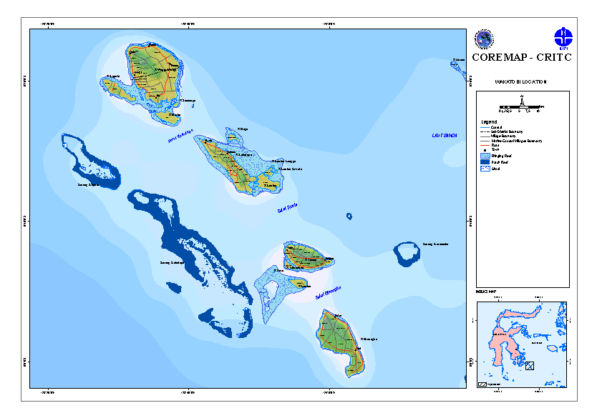
Spatial management and planning
Some regencies in eastern Indonesia are archipelagic regencies where more than 75% of their area are ocean (eg, Wakatobi and Raja Ampat)
Most of the areas are designated as marine protected areas
Two different function of regencies : autonomous regency vs conservation regency
This creates sectoral conflict making it more challenges to conserve fisheries refugees or implementing EAFM

Slide 10
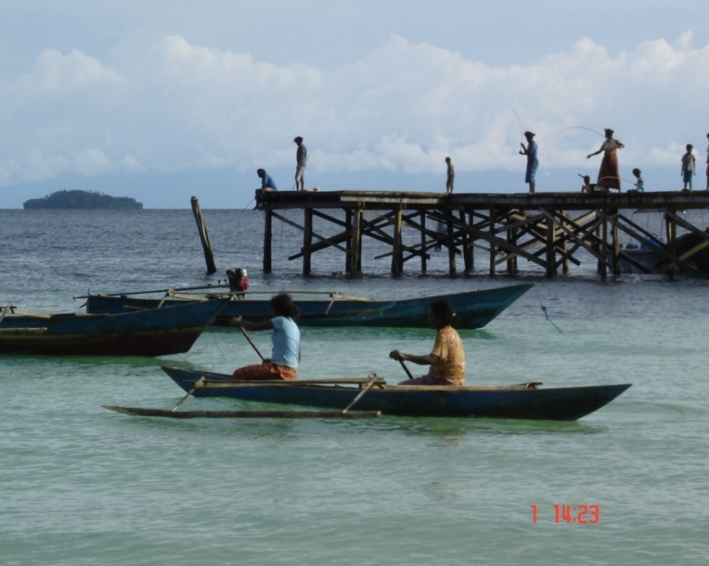
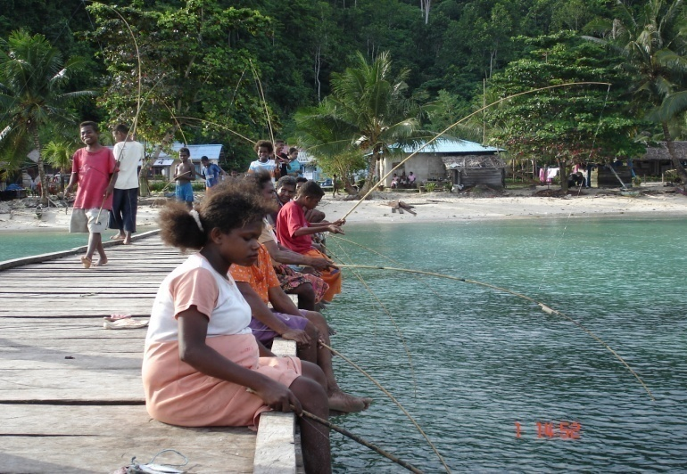
Socio-economic challenges at local levels
Fishing (including LRF fishing)is the last resort due to:
  Increase in the number population
  Limited job opportunities on terrestial
  Stiff competition on fishing related jobs
Poverty : a large number of people living under poverty line is coastal areas and at local/regencies levels
“intrusion” of fishermen from other regencies/provinces creating “free rider” and “CCPP” (Commonize cost, privatize profit) phenomena

Slide 11
Institutional aspects
Various institutions are involved in LRFF at regional levels
Conflicting regulations at local levels as LRF fishery encompass many sectors of economy
Property rights problem and higher transaction costs create insecure business
Giving exclusive concession to private sector (e.g diving business) creates tension between fishers and private sector. As a result fishers have to fish further.
Increase in cost of fishing creates spiral upward for myopic behavior for LRF

Slide 12
Local government /regencies initiatives of LRF policies: Success stories
Resource
Setting MPAs (Wakatobi, Raja Ampat)
MCS
Fishing
Prohibiting the use of hookah
Limit the number of fish caught
Market
Controlling trade license
Size control
Control by Forestry Agency for export wrasse (Agency of Natural resource conservation)
Fisher/
Communities
Public campaign (Radio, etc
Involvement of local communities
Partnership with LRFF traders
Inclusion of LRF materials into local curriculum
Communities surveillance
National/local Acts back up
Business units, NGOs, Donors back up
Mostly local Acts back up (Perda, Perdes, etc)

Slide 13
Final remarks
The government of Indonesia through its fisheries agencies both at national and regional levels has spent considerable efforts to manage the LRFF sustainably : some fail but some succeeded
Partnership with private sectors and communities has been encouraged and developed: it’s been an on going process and some work
Promoting co-management and ecosystem approach to fisheries management has been initiated with cooperation from various institutions through various programs
Improvement in data, statistics and scientific information with regard to LRF has been proposed
Several regulations have been proposed, including size limit and moratorium proposal for certain species with help from stakeholders
Complexity in regional, national and international jurisdictions calls for strong cooperation and collaboration among government units and other institutions

